Slide 1
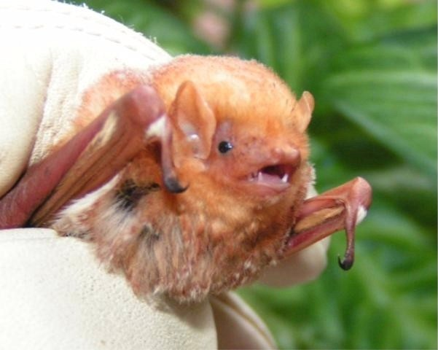
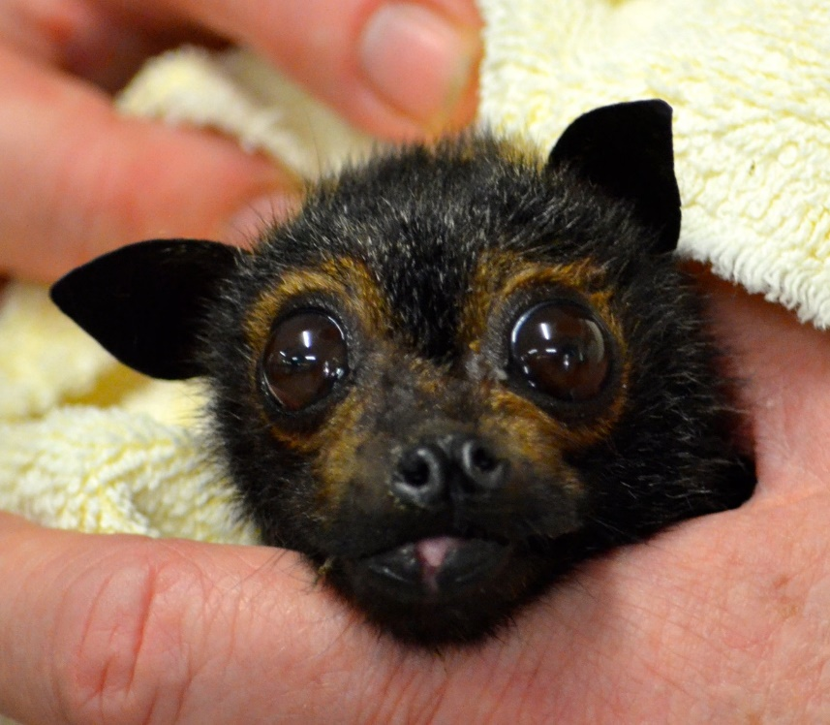
Bats of Georgia & Around the World
Vicky Beckham Smith
By: Georgia bat working group
www.youtube.com

Slide 2
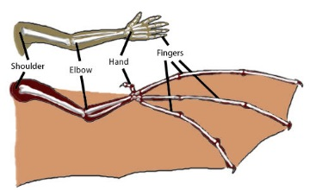
Species
Order Chiroptera (which is Greek for ‘hand wing’)
Second largest order of mammals (rodents are first)~ 20% of all classified mammal species worldwide
1,240 species worldwide
Two types: Megabats and Microbats
www.dreslough.com

Slide 3
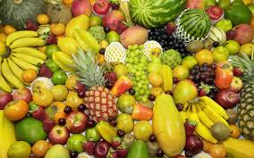
Megabats
Frugivores and nectivores
Fruit is crushed and only the They have really long tongues to juices are consumed reach into the flowers to get the
nectar
feelgrafix.com
hdwallpapersearly.com

Slide 4
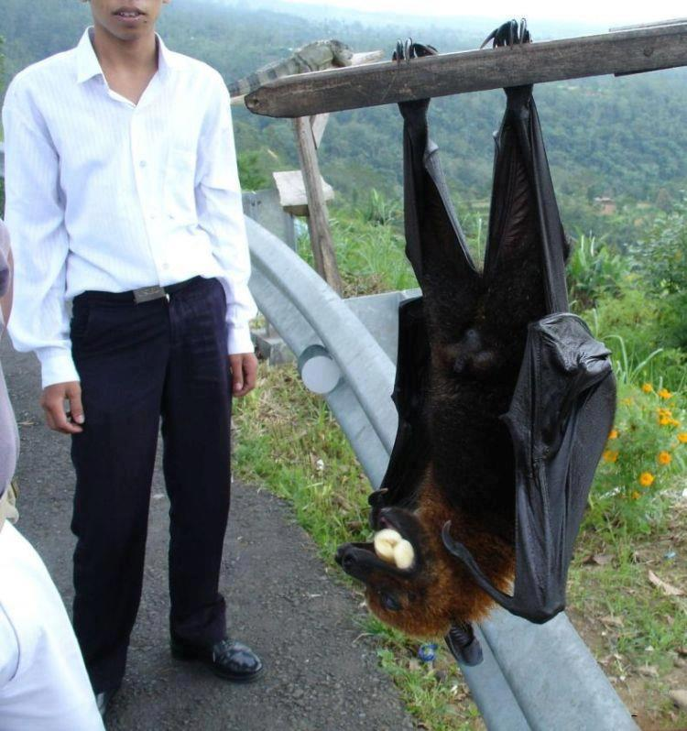
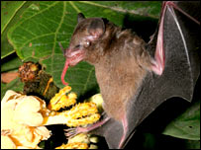
Megabats continued
Largest type of bat
Use their ears, nose, and eyes for flying and finding
prey
Most roost in trees and shrubs though some use caves
giggag.com
news.bbc.co.uk

Slide 5
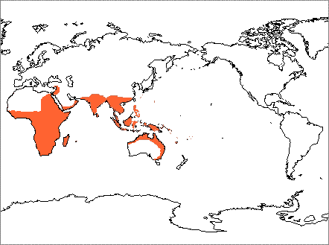
Megabat Distribution
www.nhc.ed.ac.uk

Slide 6
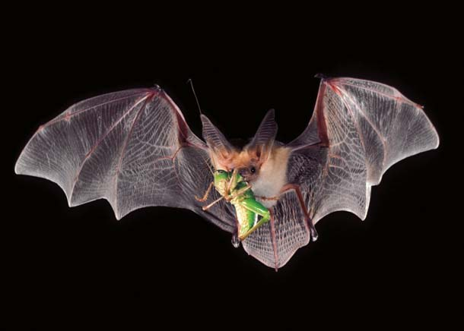
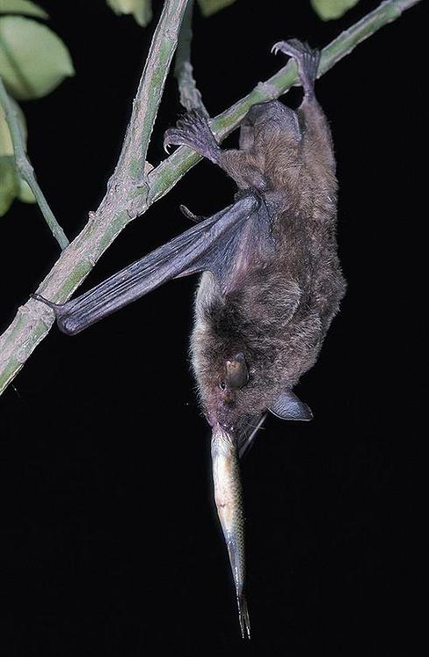
Microbats
Feed mainly on insects, but also hunt other small invertebrates, birds, other bats, lizards, frogs, fish, and some drink the blood from other animals
All species in GA are insectivorous
Insectivorous and Carnivorous
www.bio.bris.ac.uk
askmax.countrymax.com

Slide 7
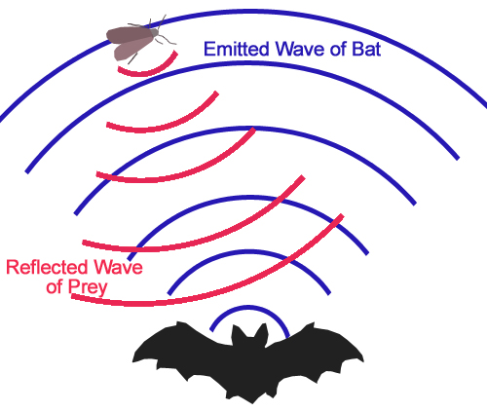
Microbats Cont
Make up 70% of all bat species
Use echolocation (finding objects through echoed sound) to locate food
Have excellent eyesight
Roost in caves, trees, man-made
structures, and even in the leaf litter
on the ground, depending upon the
species of bat
commons.wikimedia.org

Slide 8
Microbat Distribution Distribution: All over the world except in the Arctic and Antarctic 16 species found in GA
www.nhc.ed.ac.uk

Slide 9
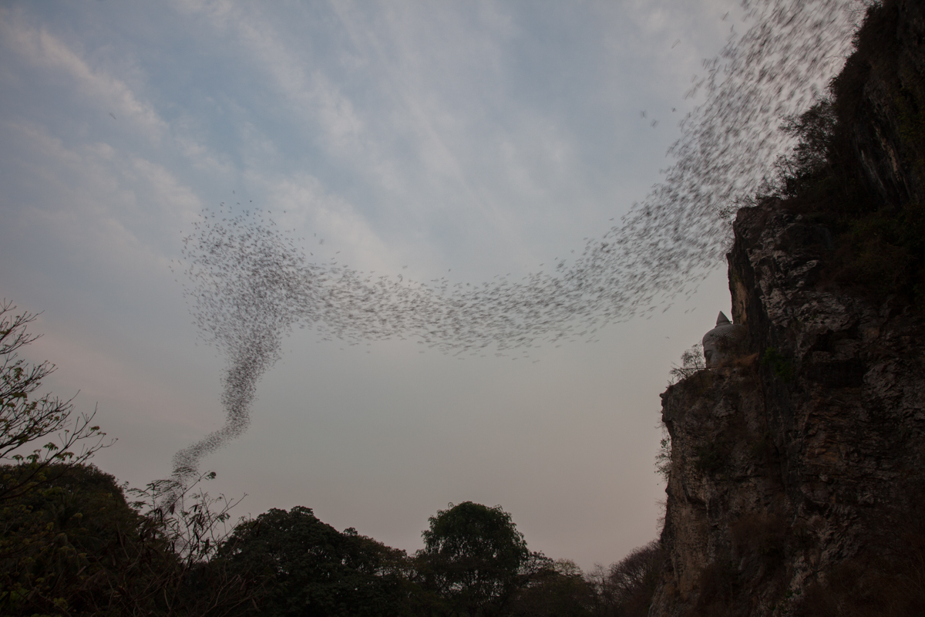
Why are Microbats Important in Georgia?
Eat about 300-500 mosquitoes and other insects in an hour
Help control insect populations
Save farmers tons of money each year in pesticide use and crop protection
www.chrisandchrisbreakfree.com

Slide 10
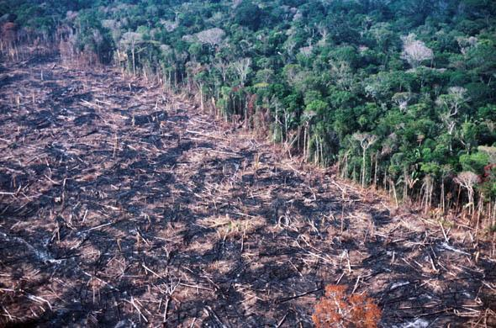
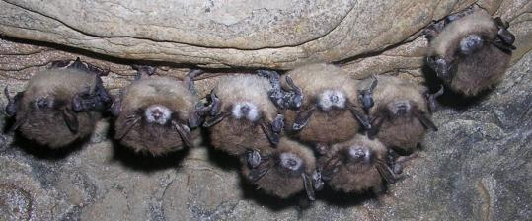
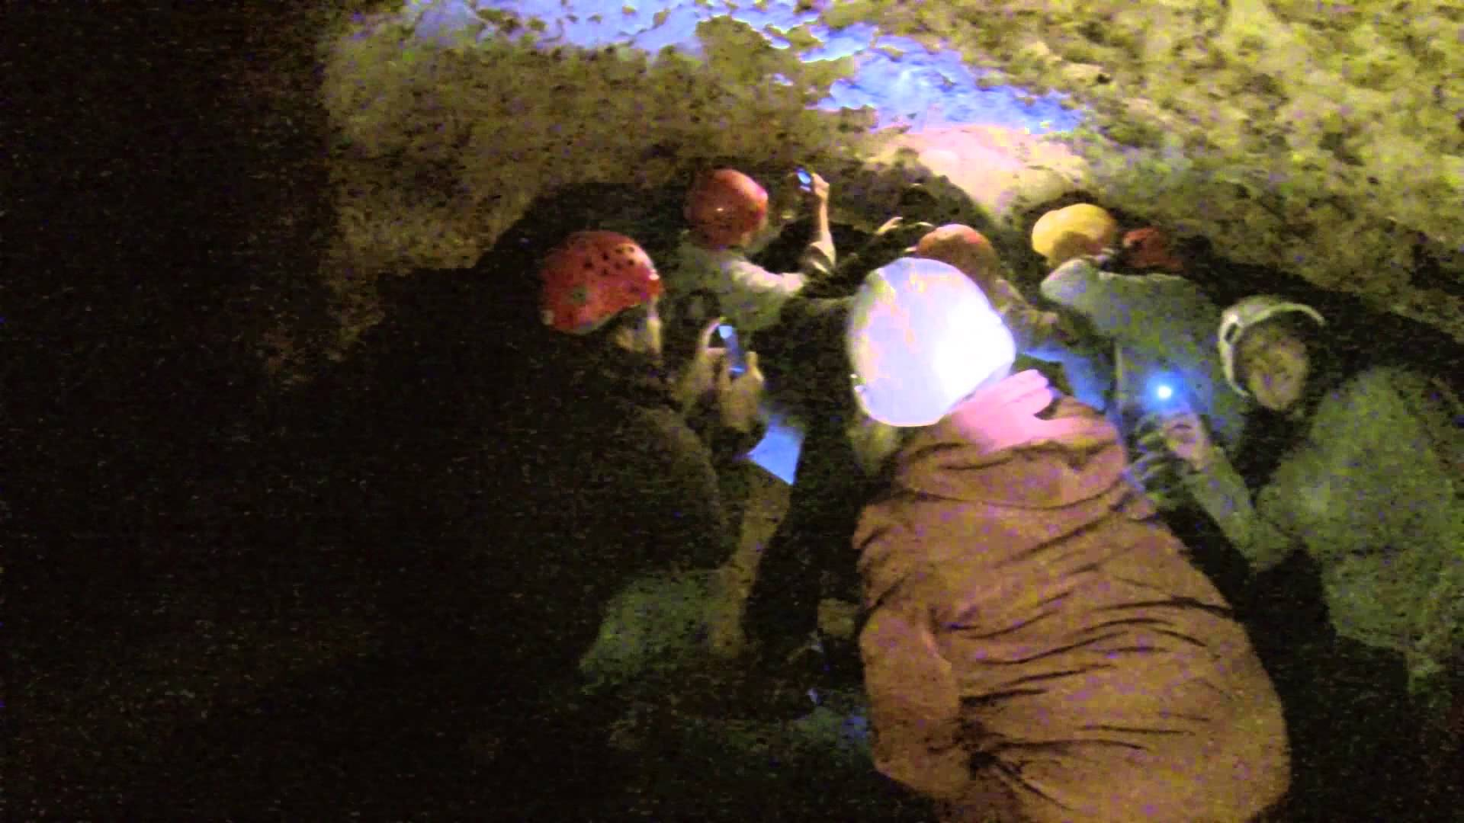
Losing our Bats
Deforestation
Disturbance in Caves
White Nose Syndrome (WNS)
www.ibtimes.com
www.fws.gov
www.youtube.com

Slide 11
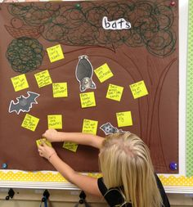
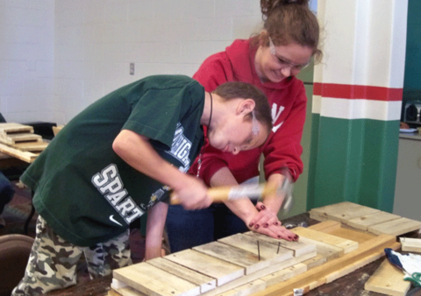
What Can You Do to Help?
Share with others what you have learned about bats
Get together with friends or your boy scout or girl scout group and build a bat house in a state park or along a greenway with their permission.
www.pinterest.com
www.batconservation.org

Slide 12
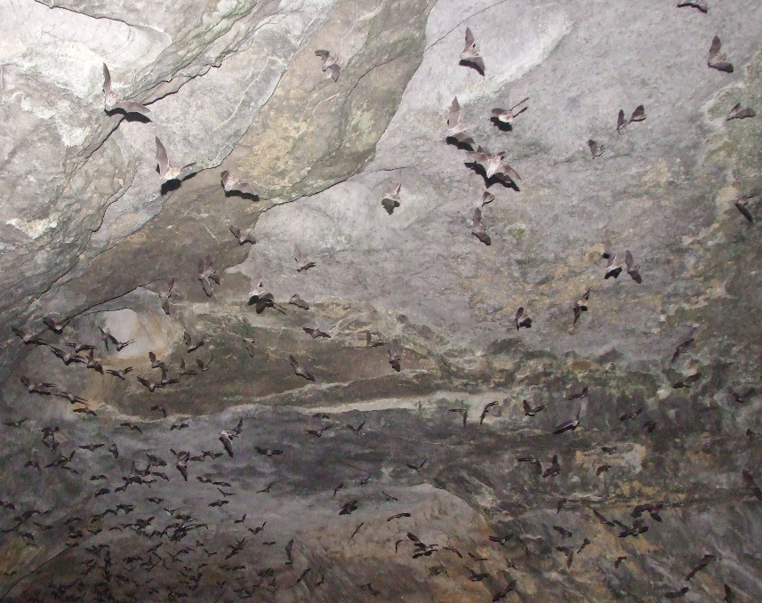
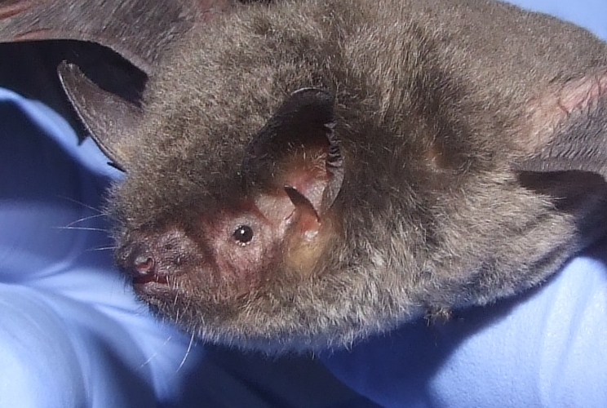
For more information, go to: www.georgiawildlife.com http://www.gabats.org Or For classroom activities about bats to engage students: www.Pinetrest.com www.batcon.org
Vicky Beckham Smith
Vicky Beckham Smith

