Slide 1
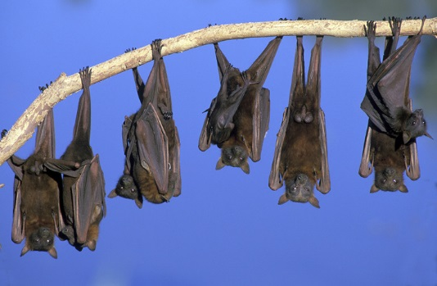
Bats of Georgia & Around the World
Vicky Beckham Smith
By: Georgia Bat Working Group
crowarrowinc.wordpress.com

Slide 2
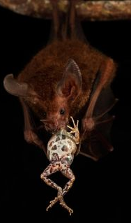
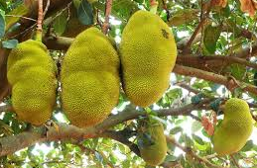
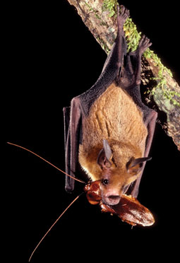
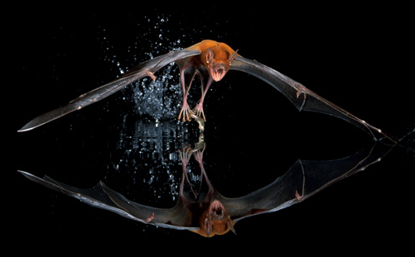
Species
Order Chiroptera (which is Greek for ‘hand wing’)
Second largest order of mammals (rodents are first)~ 20% of all classified mammal species worldwide
1,240 different species worldwide
Two suborders:
Megabats and Microbats
www.globalvillagefruit.com
www.hdwallpaperscool.com
news.mongabay.com
www.vnews.com
smithsonianscience.org

Slide 3
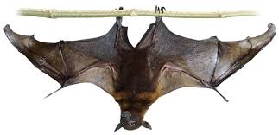
Megabats
www.dkfindout.com
Smallest species is 2.4 inches long and 25 grams
Largest is 5.6 feet in wingspan and weighs 3.5 pounds
They use their ears, nose, and eyes for getting around and finding their food
Most roost in trees and shrubs though some roost in caves
Smaller bats can hover while eating fruit, but the larger bats must land.

Slide 4
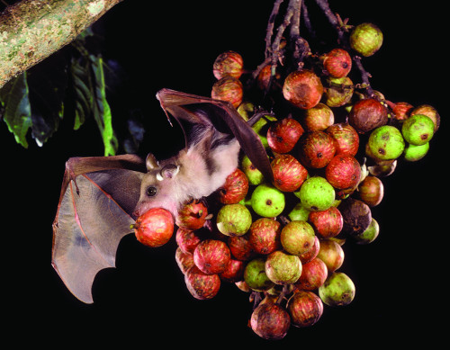
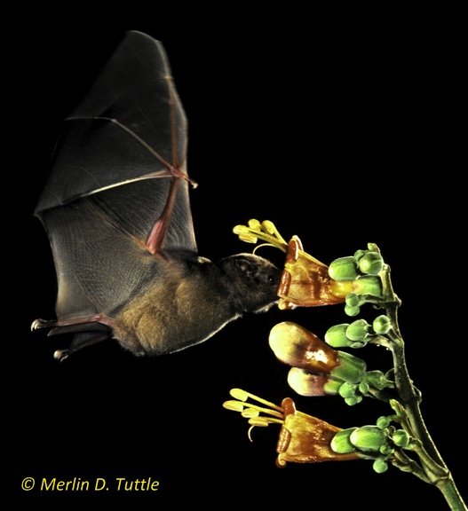
Benefits of Megabats
Pollinators
Nectar-eating bat species pollinate much of the produce you see at your local supermarket. Such as: bananas, peaches, mango, durian, guava, and agave (tequila), among others
Seed Distributors
Fruit-eating bats disperse seeds critical to restoring cleared or damaged rainforests
Sometimes called“Farmers of the tropics”
Avocados, dates, figs and cashews, among others are plants that benefit from bats seed dispersal

Slide 5
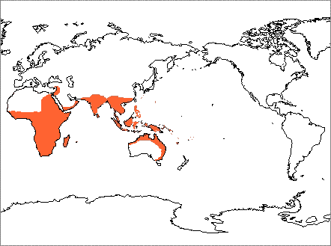
Megabat Distribution
www.nhc.ed.ac.uk

Slide 6
Microbats
Vicky Beckham Smith
Smallest species is 1.14 inches long and weighs 2 grams
Largest is 39 inches in wingspan and weighs 190 grams
Use echolocation to find their food, which uses minimal energy in correlation to their body size
Have good sight– helps in flight at night
Roost in caves, trees as well as man-made structures
Most feed on insects; however, some hunt other small invertebrates, birds, lizards, frogs, other bats, fish, and some feed on blood from other animals
Most glean insects while in the air

Slide 7
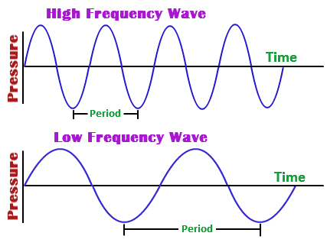
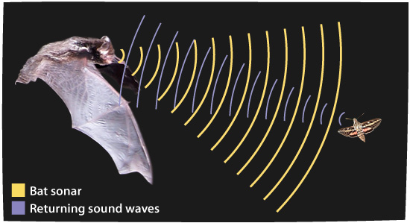
Microbats and Echolocation
Microbats generate ultrasound via the larynx and emit the sound through the nose or the open mouth. Microbat calls range in frequency from 14,000 to over 100,000 hertz, Hz (typical human hearing range is considered to be from 20 to 20,000 Hz).
The sound produces an echo which then transmits back to the bat so that they know how far away they are from prey or an object.
www.antipest.com.my
physics.tutorvista.com

Slide 8
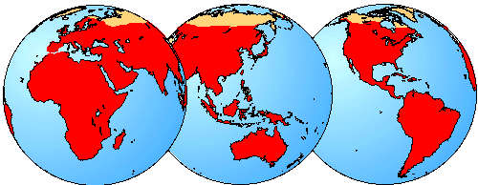
Microbat Distribution
16 species found here in GA
All over the world except in the Arctic and Antarctic
www.nhc.ed.ac.uk

Slide 9
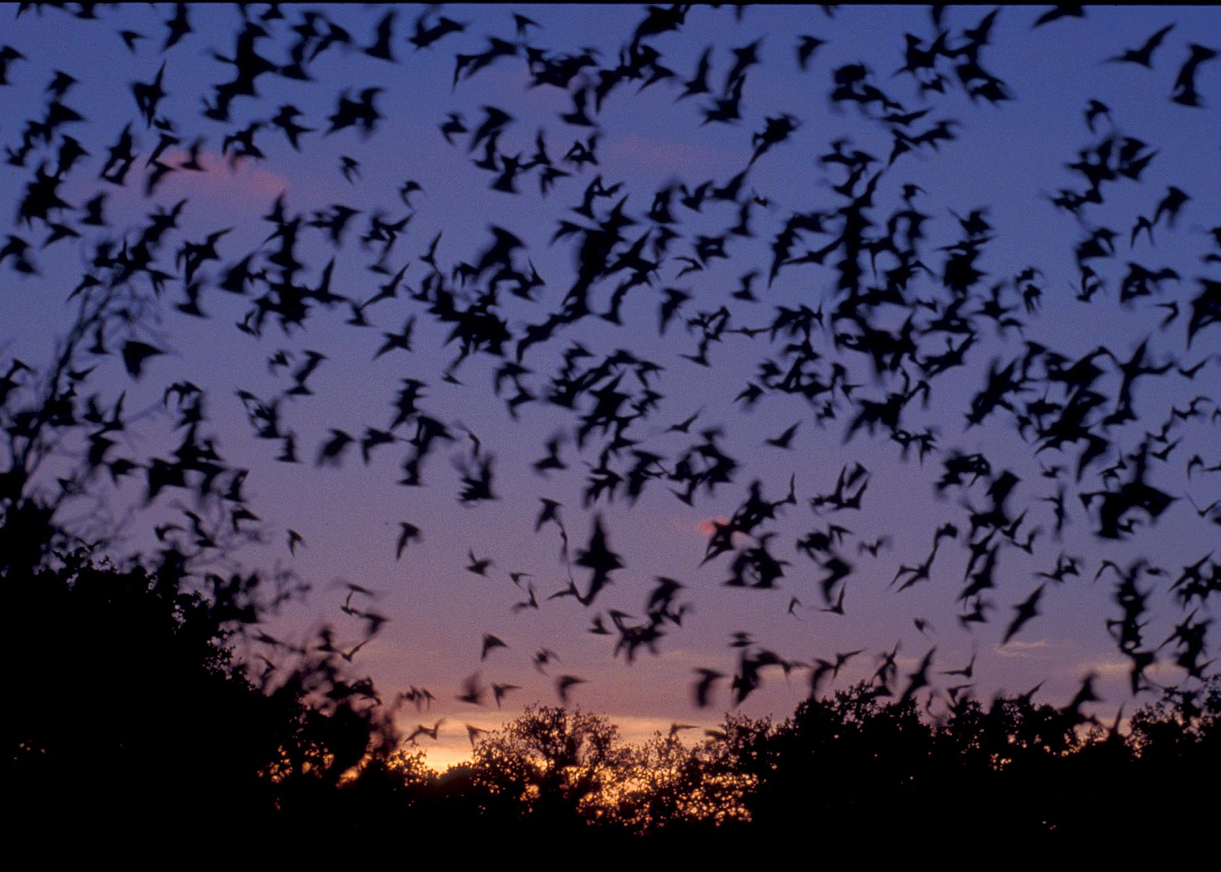
Why are Microbats Important in Georgia?
They can consume 300-500 mosquitoes and mosquito sized insects in one hour!
Help maintain a fragile insect predator-prey balance for our ecosystem
Save farmers billions of dollars in pesticide use and crop protection
Help maintain healthy crops for farmers and foresters.
The alternative to bats is greater pesticide use, which brings another set of ecological concerns
soundandsensibility.wordpress.com

Slide 10
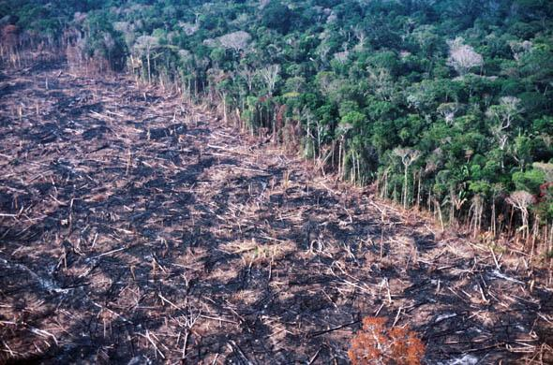
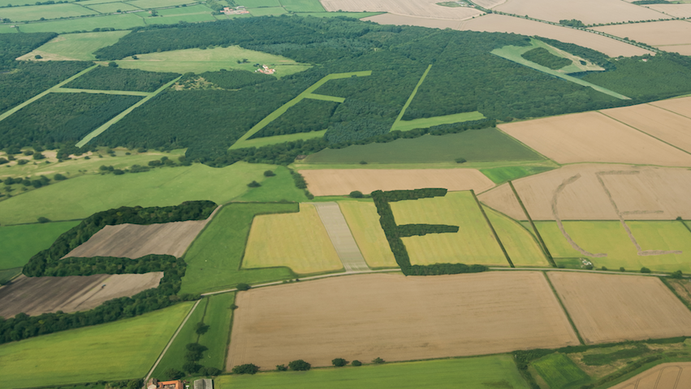
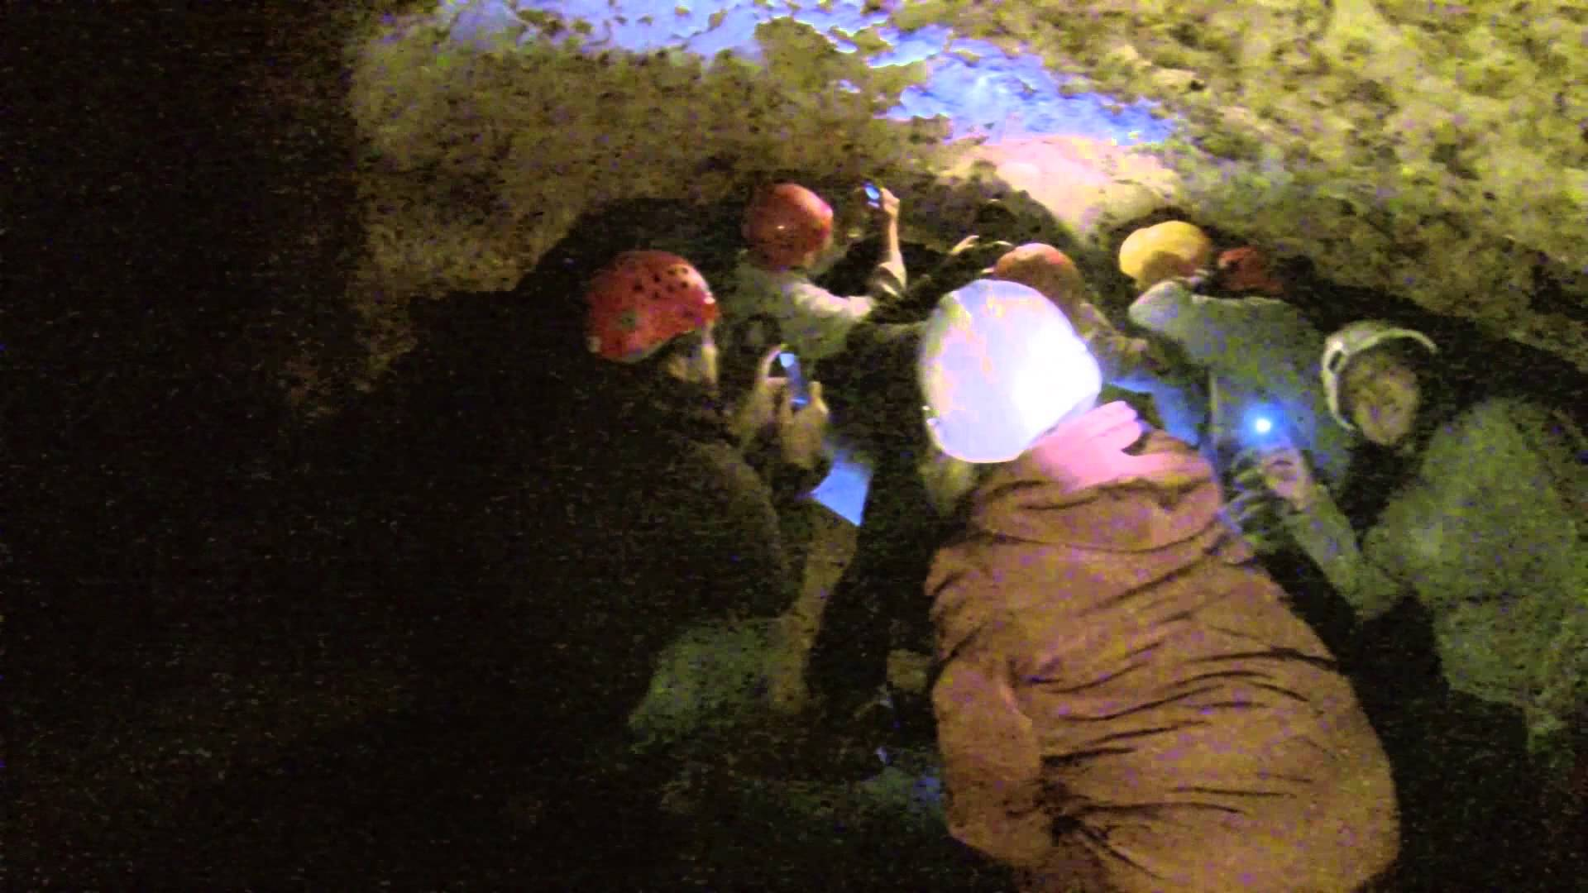
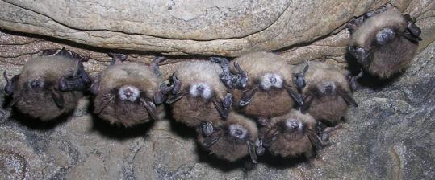
Losing our Bats Worldwide
Deforestation
Disturbance in caves
Habitat fragmentation
White-nose syndrome
www.ibtimes.com
www.npr.org
www.youtube.com
www.fws.gov

Slide 11
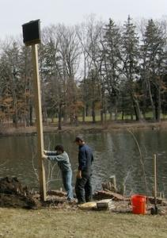
What can you do to help?
EDUCATE others about what you learned here today about bats
Build a bat house behind your house, in a park, or along a greenway (parks and greenways you will need to acquire permission)
Volunteer with biologists and researchers in the cause
Be mindful when caving and decontaminate any gear used
https://www.whitenosesyndrome.org/sites/default/files/resource/national_wns_revise_final_6.25.12.pdf
www.wvgazette.com
www.batconservation.org

Slide 12
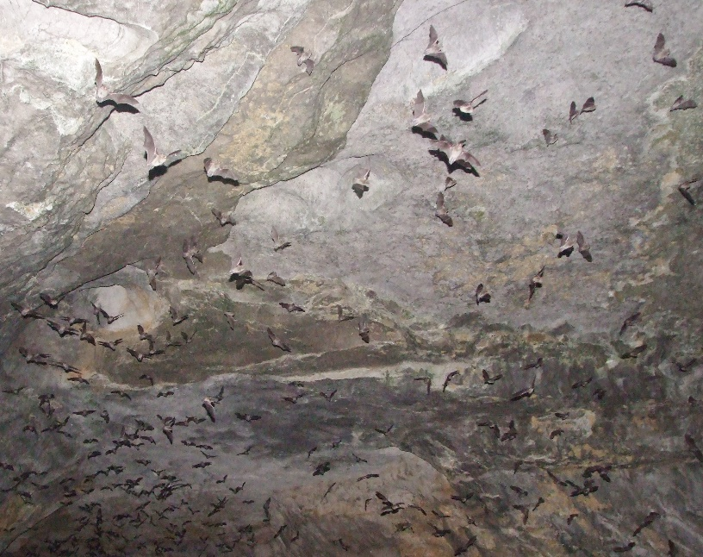
For more information, go to: www.georgiawildlife.com http://www.gabats.org Or For classroom activities about bats to engage students: www.Pinetrest.com www.batcon.org

