Slide 1
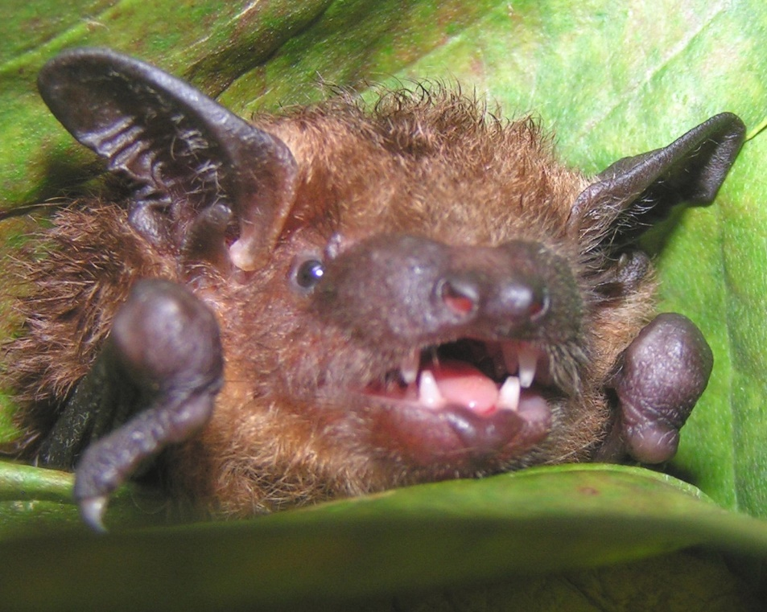
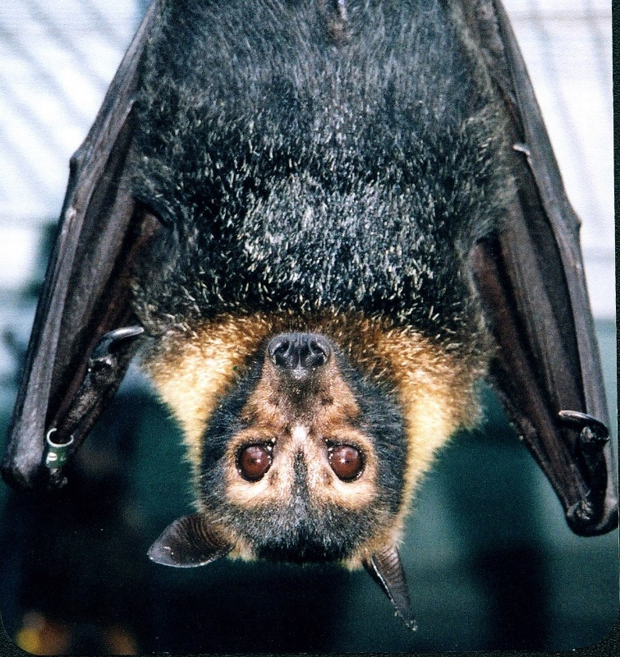
BaTs OF Georgia & AROUND the world
Vicky Beckham Smith
By: Georgia Bat Working Group
Vicky Beckham Smith

Slide 2
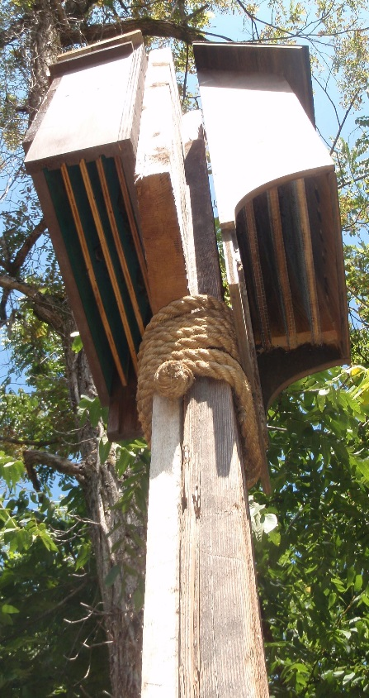
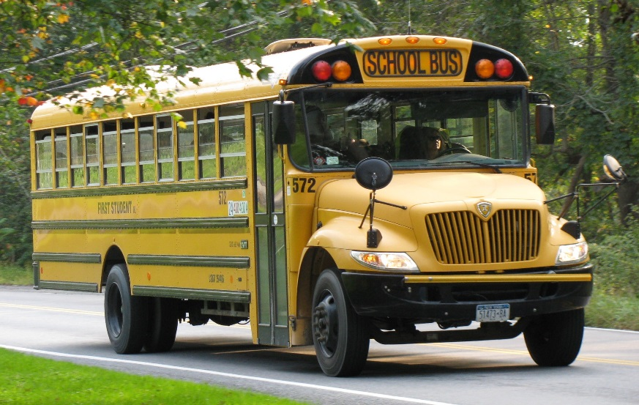
Species
1,240 species worldwide---divided into 2 groups---Microbats and Megabats
* that same number of humans would fill 23 school buses
* that same number of microbats would fill 6 bat houses like the one below
en.wikipedia.org
Dottie Brown

Slide 3
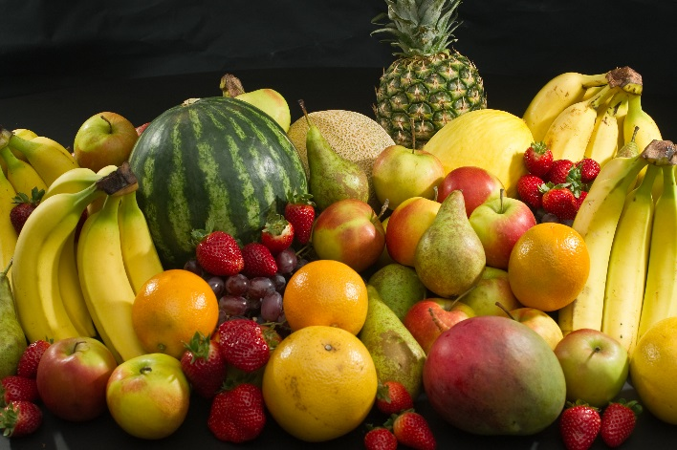
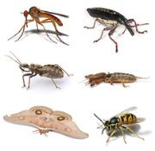
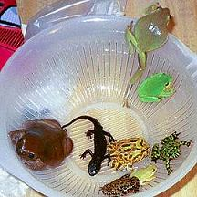
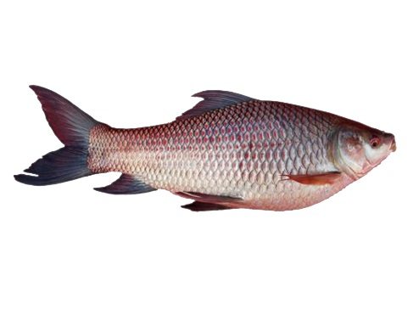
What do they eat?
Megabats food
Nectar from flowers and fruit
Microbats food
insects, other small invertebrates,
other bats, birds, lizards, frogs,
fish, blood
en.wikipedia.org
en.wikipedia.org
dbmlag.info
www.amphibiancare.com
khatibazar.com

Slide 4
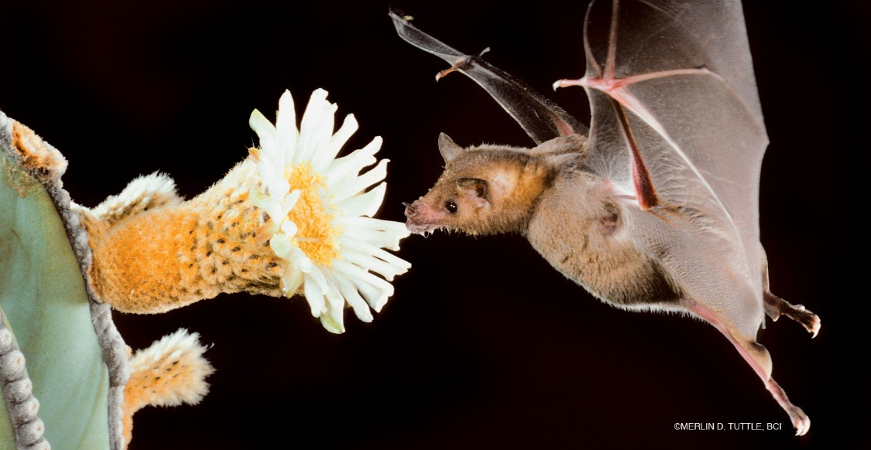
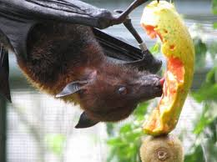
Megabats
Not only do these species feed on fruits, they are some of the world’s most important pollinators.
Merlin D Tuttle, BCI
mentalfloss.com
imgbuddy.com

Slide 5
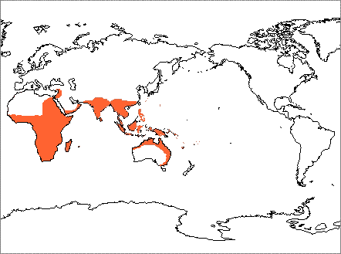
MEGAbats cont
Distribution
www.nhc.ed.ac.uk

Slide 6
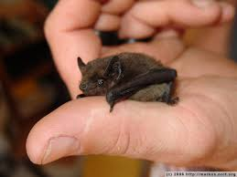
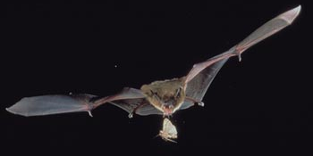
microbats
They can eat between 300-500 mosquitoes and mosquito sized insects in the same amount of time you have your school lunch!
Bats help to control populations of insects that carry diseases, such as mosquitoes, as well as the many insects that eat and spoil all the crops that are gathered to be shipped to our supermarkets.
http://markus.nolf.org
www.fcps.edu

Slide 7
Microbats cont
Microbats use echolocation in order to find the insects they eat.
https://www.youtube.com/watch?v=bAvoz_ofoeo

Slide 8
Microbats cont
Distribution
16 species found here in GA
Located all over the world except in the Arctic and Antarctic
www.nhc.ed.ac.uk

Slide 9
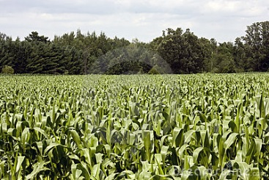
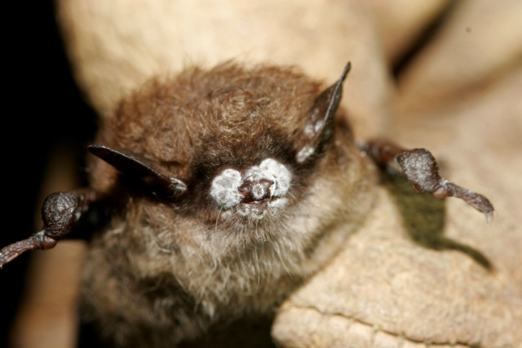
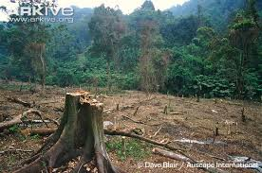
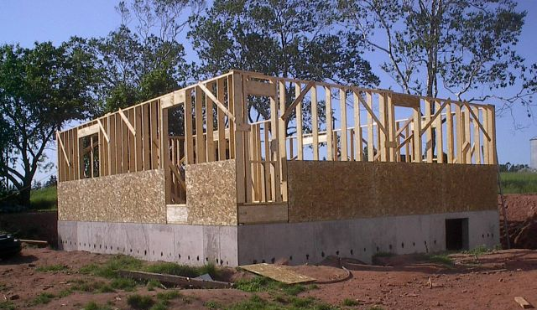
Losing our bats worldwide
Some of the major losses of bat populations are due to the cutting down of trees and using it for farmland or building other things in their place.
In the US, Canada, and Europe there is a fungus that causes the disease known as White Nose Syndrome (WNS). Bats that have the disease wake up during winter when they should be sleeping in caves and saving their energy. Because there are no insects for them to feed on, bats that are too active during cold winter months use up their energy reserves and die.
WNS
Crop
Tree Clearing
www.dreamstime.com
Houses
newvoicesforresearch.blogspot.com
www.cbsnews.com

Slide 10
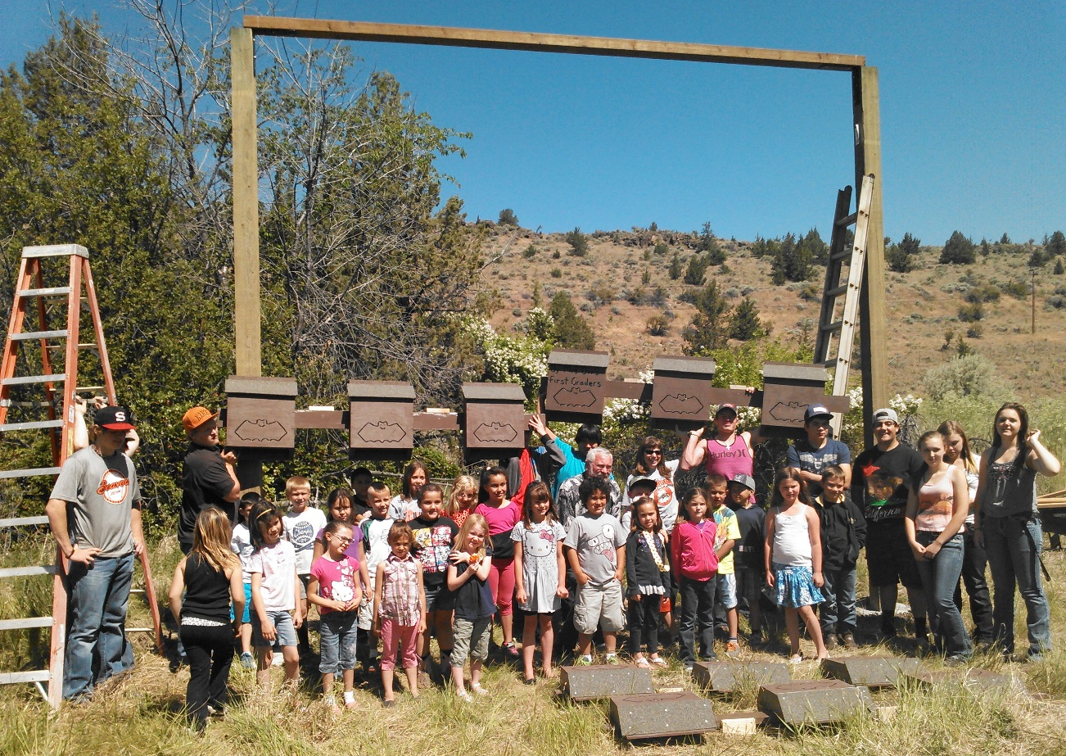
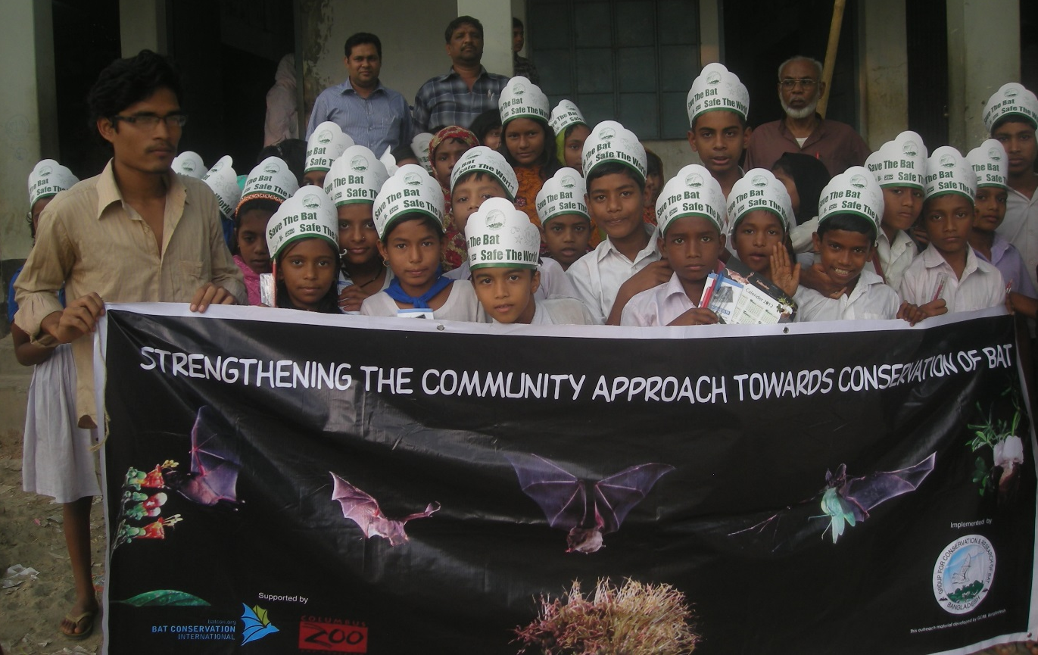
What can you do to help?
Tell your friends and family how cool bats are and what they do for our environment.
Get permission from a state park or a local greenway to have your school or boy scout or girl scout group build a bat house for them
covepalisades.wordpress.com
www.seabcru.org

Slide 11
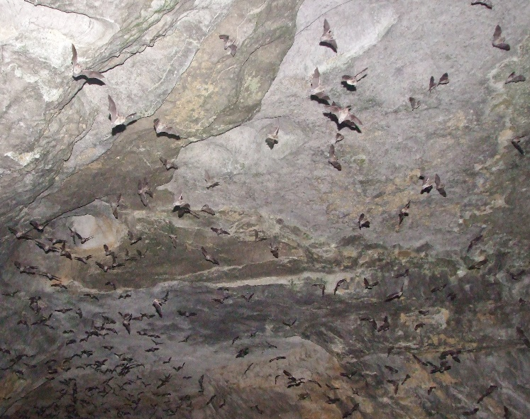
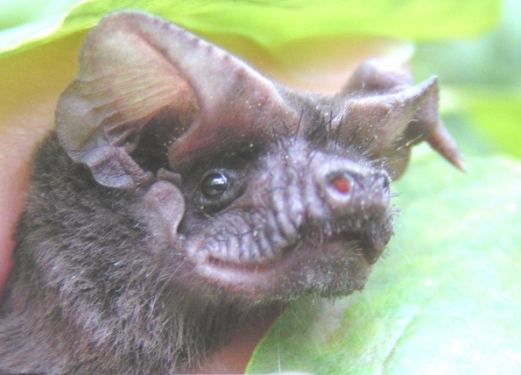
For more Information, go to: www.georgiawildlife.com www.gabats.org Or For classroom activities about bats to engage students: www.Pinetrest.com www.batcon.org
Vicky Beckham Smith
Vicky Beckham Smith

