Slide 1
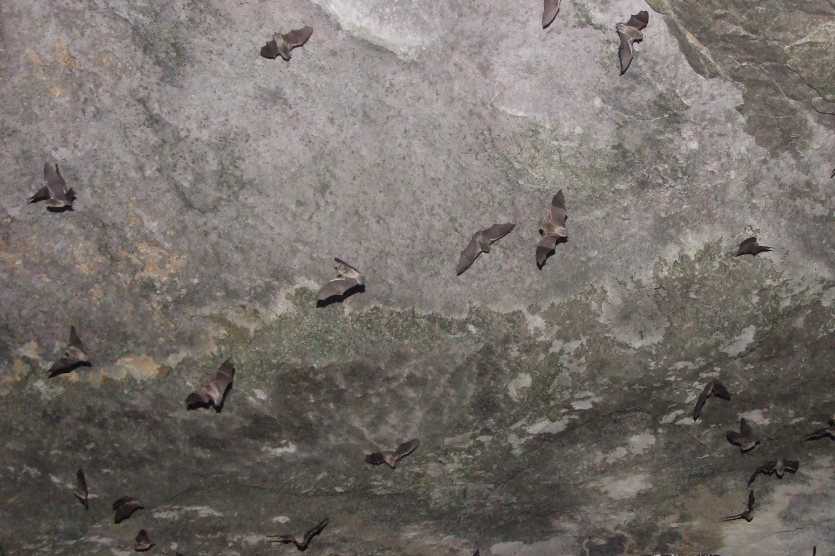
BaTs OF Georgia & AROUND the world
By: Georgia Bat Working Group
Vicky Beckham Smith, A-Z Animals

Slide 2
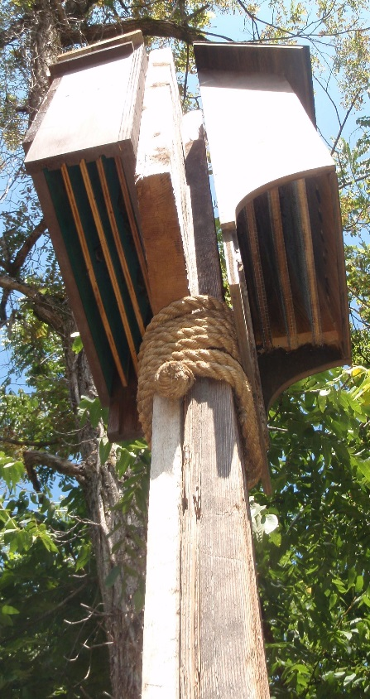
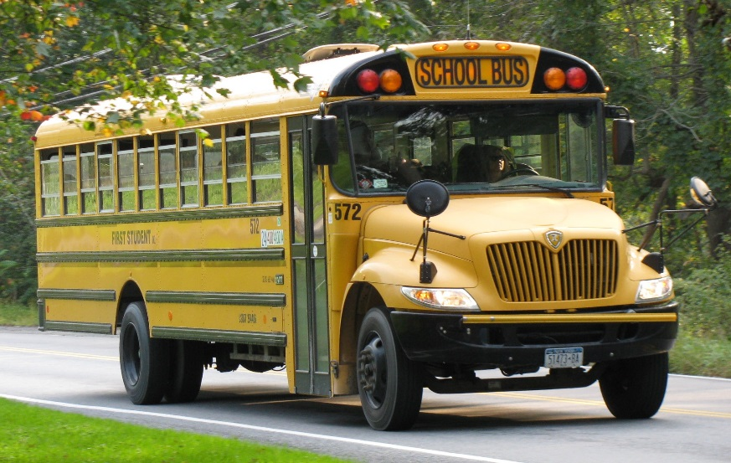
Species
Over 1,200 species worldwide, it would take 23 school buses to hold 1,200 humans. It would take 6 bat houses, like the ones pictured to the right, to hold 1,200 bats.
Over 45 species in the USA
16 species found here in GA
en.wikipedia.org
Dottie Brown

Slide 3
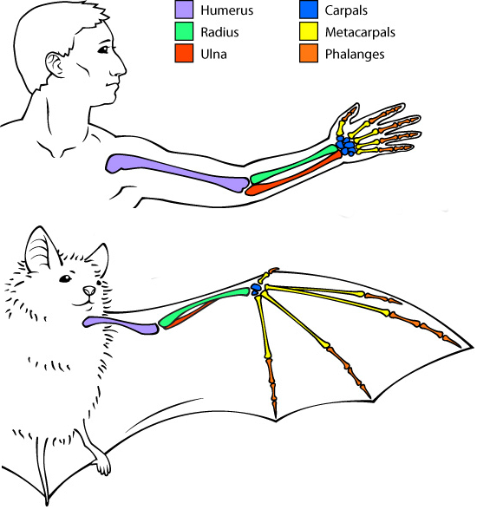
Bats belong to the Order Chiroptera (which is Greek for ‘hand wing’)
Second largest order of mammals (rodents are first)~ 20% of all classified mammal species worldwide
Only mammal capable of flight
Two groups: Megabats and Microbats
www..askabiologist.asu.edu

Slide 4
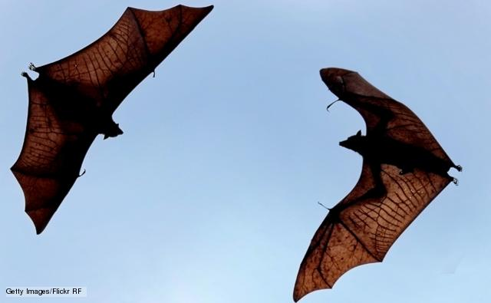
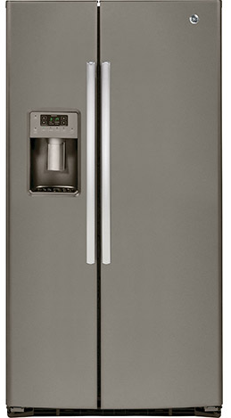
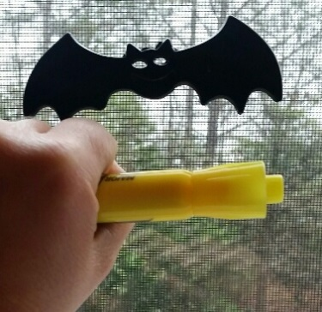
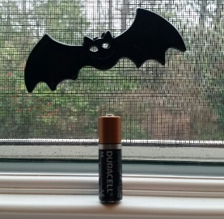
Megabats
Largest type of bat
Smallest species is 2.4 inches long (half of highlighter or bic pen) and 25 grams (AA battery)
Largest is 5.6 feet in wingspan (refrigerator) and weighs 3.5 pounds (3.5 water bottles)
Use their ears, nose, and sight for flying and finding their food, some use tongue clicks for echolocation
Mostly roost in trees and shrubs, although some are found in caves
Smaller bats can hover while eating fruit, but the larger bats must land
Great pollinators and seed distributors
Helping to reproduce agave, bananas, mangoes, avocadoes, and cashews
bbc.co.uk
Kim Chase
google.com
Kim Chase

Slide 5
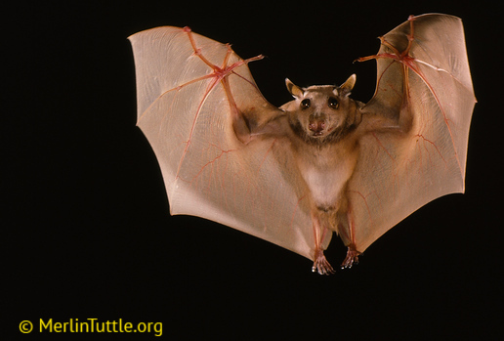
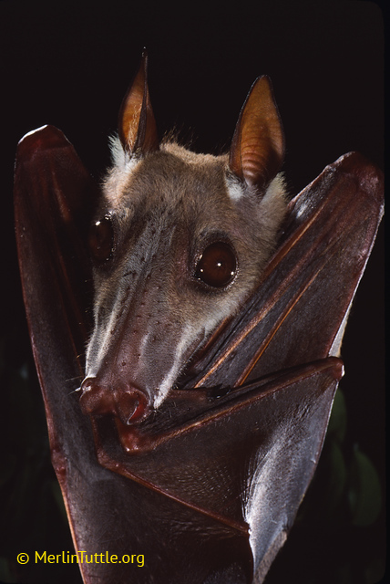
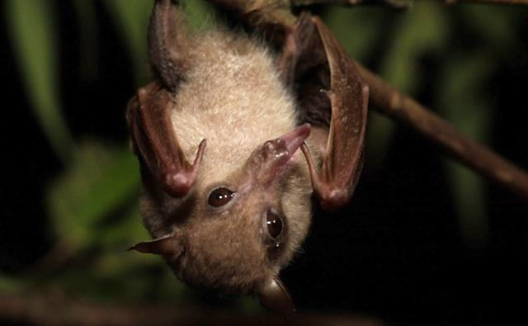
bbc.co.uk

Slide 6
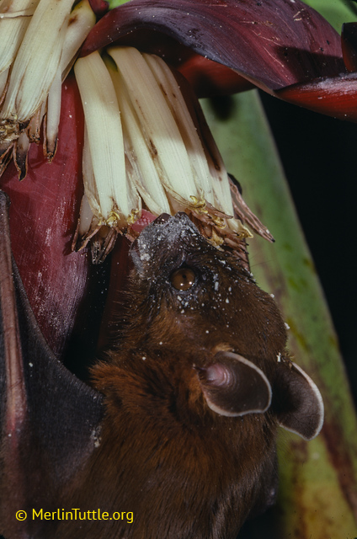
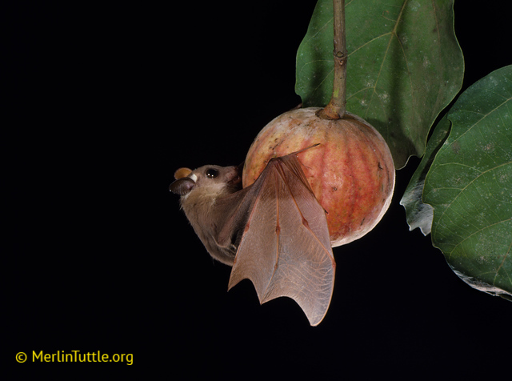
What do they eat?
Nectar, pollen and flowers
Fruit and leaves

Slide 7
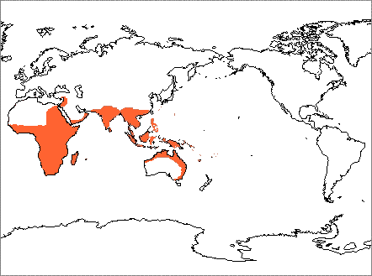
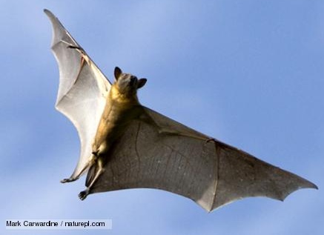
Distribution
Old World Tropics
bbc.co.uk
www.nhc.ed.ac.uk

Slide 8
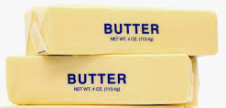
microbats
They can eat between 300-500 mosquitoes and mosquito sized insects in the same amount of time you have your school lunch (~30 min)!
Bats help to control populations of insects that carry diseases, such as mosquitoes, as well as the many other insects that eat and spoil all the crops
Smallest species is 1.14 inches long (paperclip) and weighs 2 grams (2 dollar bills)
Largest is 39 inches in wingspan (width of twin bed) and weighs 190 grams (2 sticks of butter)
Use Echolocation (finding objects through echoed sound) to find food
Most have good sight– helps in flight at night
Mostly roost in caves and trees, but also use bridges, man-made structures (houses and bat boxes), and rocks
Most catch insects while in the air
Vicky Beckham Smith, A-Z Animals
Width
google.com
google.com

Slide 9
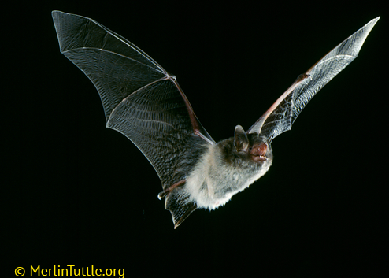
Kim Chase
© MerlinTuttle.org

Slide 10
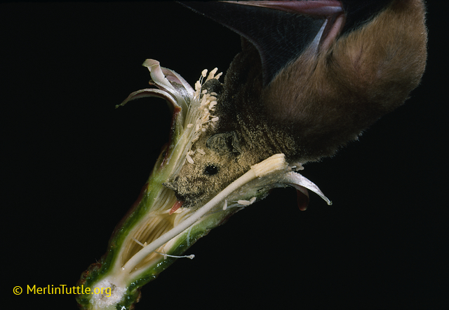
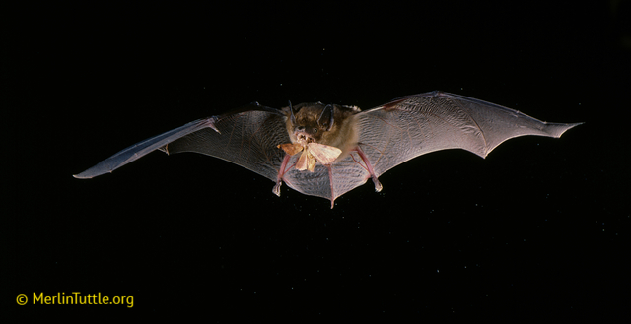
What do they eat?
Nectar from flowers and fruit
Insects, other bats, birds, lizards, frogs, fish, and blood

Slide 11
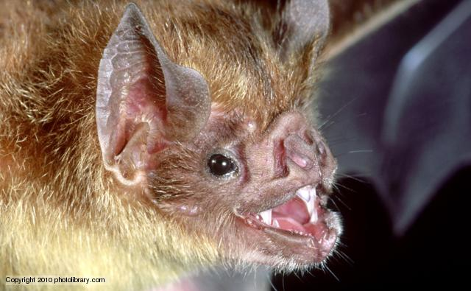
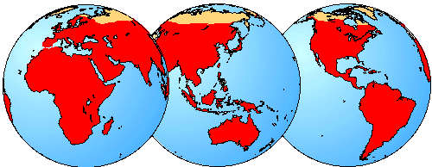
Distribution
All continents except Antarctica
bbc.co.uk
www.nhc.ed.ac.uk

Slide 12
All insectivorous, eat their body weight in insects helping prevent insect-born diseases and reduce crop pesticide use
Endangered (e) and threatened (t) species in GA:
Gray Bat (e)
Indiana Bat (e)
Northern long-eared Bat (t)
Gray bats live in caves year round, but can be found in culverts and under bridges
Indiana bats and northern long-eared bats are in caves during the winter and roost in trees in the summer.
Northern long-eared bats can also be found in the roofs of houses and under bridges
Taken by: Kim Romano
Poster made by: BCI, T.E.R.N., and GA Power

Slide 13
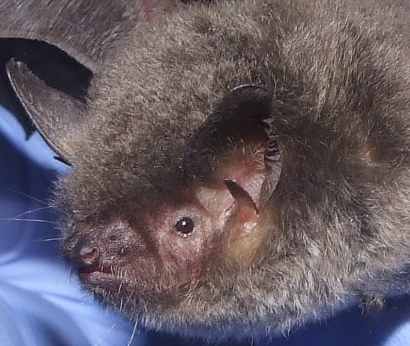
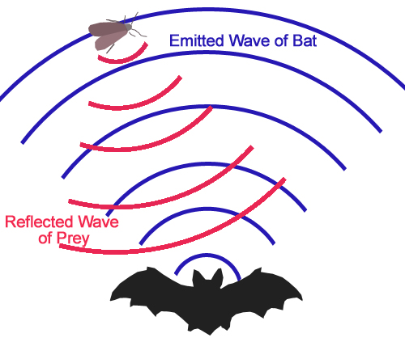
Echolocation
Microbats use echolocation in order to find the
insects they eat.
https://www.youtube.com/watch?v=bAvoz_ofoeo
Vicky Beckham Smith
A-Z Animals
commons.wikimedia.org

Slide 14
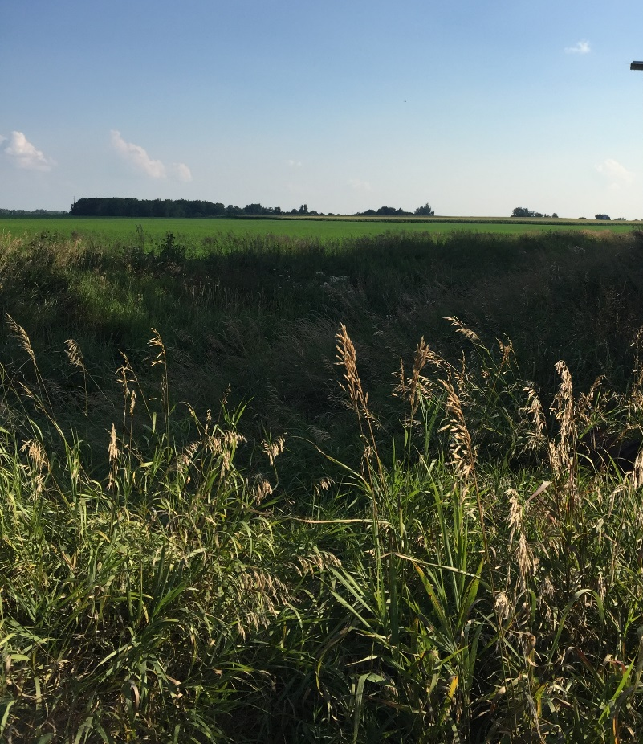
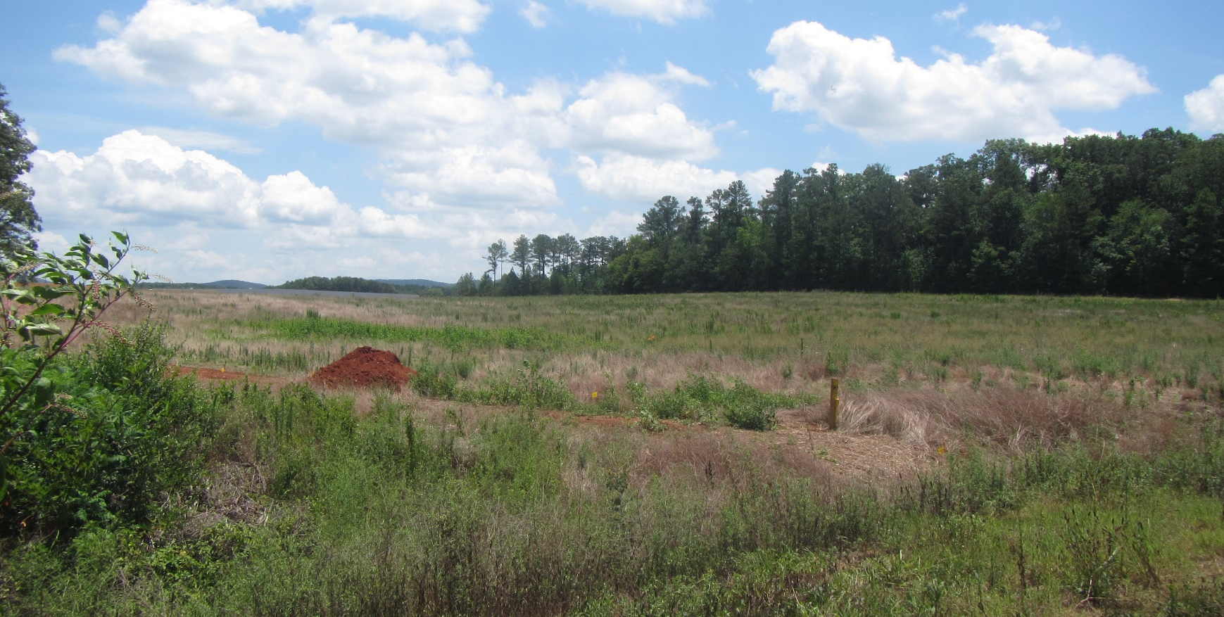
Losing our bats worldwide
Some of the major losses of bat populations are due to the cutting down of trees (deforestation) and using it for farmland or building other things in their place.
tree clearing cropland
Ecological Solutions, Inc.
Ecological Solutions, Inc.

Slide 15
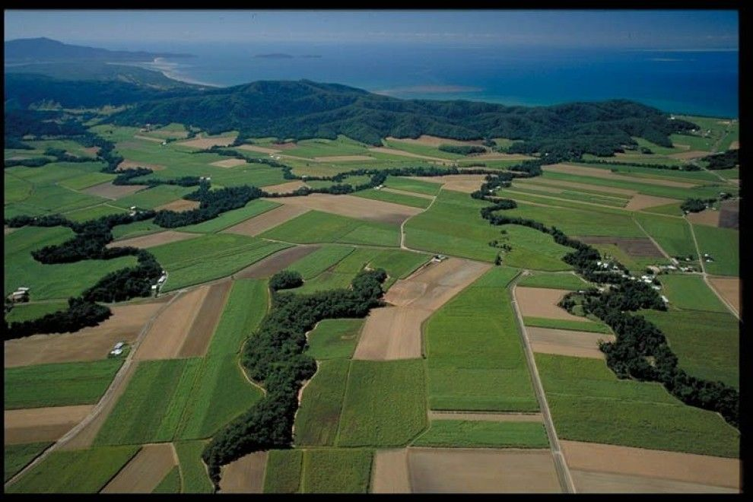
Other factors influencing declines
Wind turbines
Habitat fragmentation
https://www.gerenewableenergy.com/
www.gardenerscoach.com

Slide 16
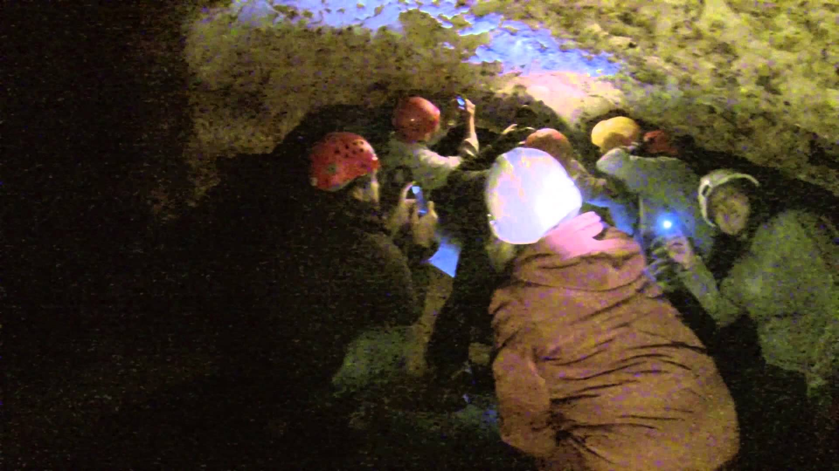
Losing our bats in the Eastern US
Disturbance in caves
In the US, Canada, and Europe there is a fungus (Pseudogymnoascus destructans, Pd) found in caves that causes the disease known as White Nose Syndrome (WNS). Since 2006, WNS has killed more than 6 million bats, and is documented in 30 states. Bats that have the disease/fungus wake up during winter when they should be sleeping in caves and saving their energy. Because there are no insects for them to feed on, bats that are too active during cold winter months use up their energy reserves and die.
WNS
www.youtube.com
Ecological Solutions, Inc.

Slide 17
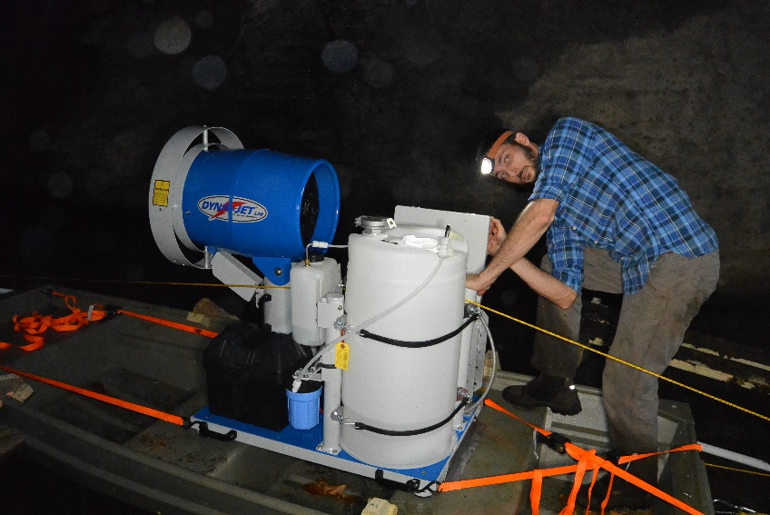
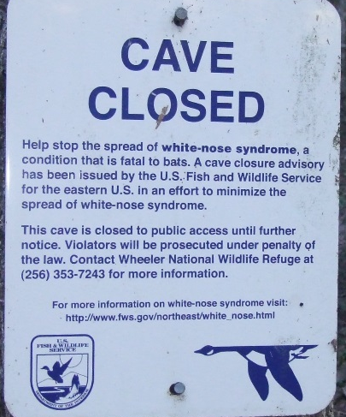
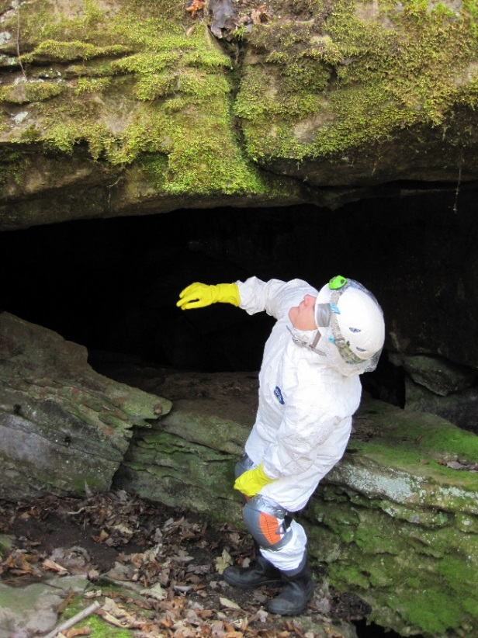
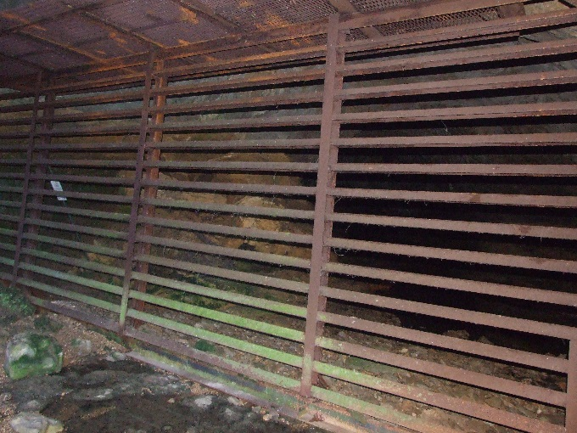
The Future for Bats with WNS
Pete Pattavina, USFWS
The closing and gating of caves
Research is being done to help save bats:
Yearly or bi-yearly cave surveys for confirmed presence or absence of Pd, as well as bat counts
Different treatments and trials with confirmed Pd:
Directly applying anti-fungal loads to infected bats
Applying anti-fungal loads via spray mist within infected, but controlled structures (mines)
Sanitizing infected areas
The cooling of infected areas to create an
in-hospitable environment for Pd.
Vaccine development
Medicines
Artificial hibernacula
Vicky Beckham Smith, A-Z Animals
Tom Whitehurst, SCCI caver

Slide 18
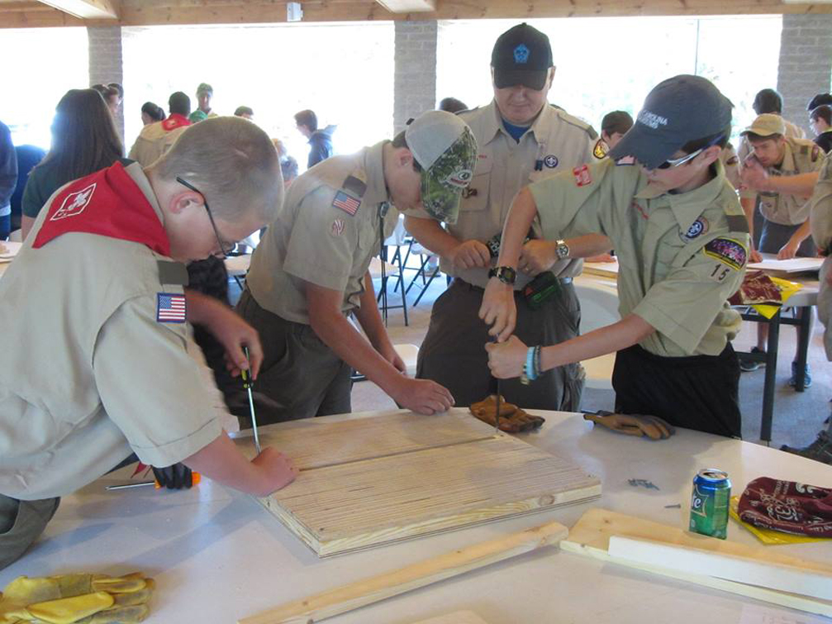
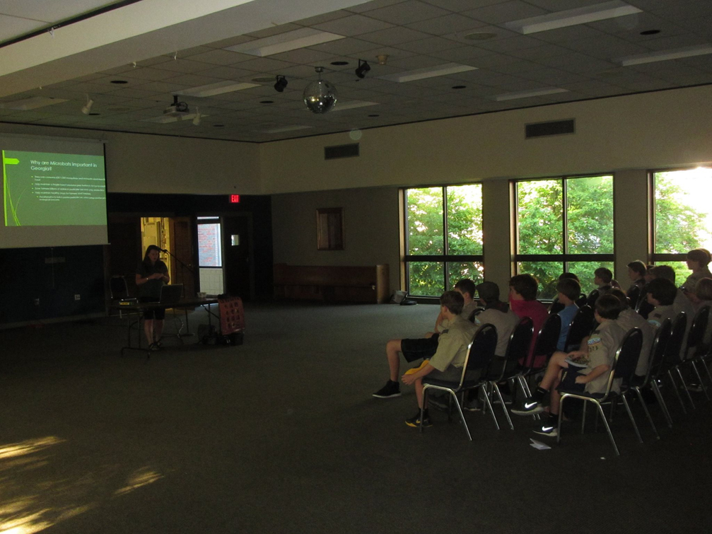
What can you do to help?
Tell your friends and family how cool bats are and what they do for our environment
Get permission from a state park or a local greenway to have your class or boy scout or girl scout group build a bat house for them
Ecological Solutions, Inc.

Slide 19
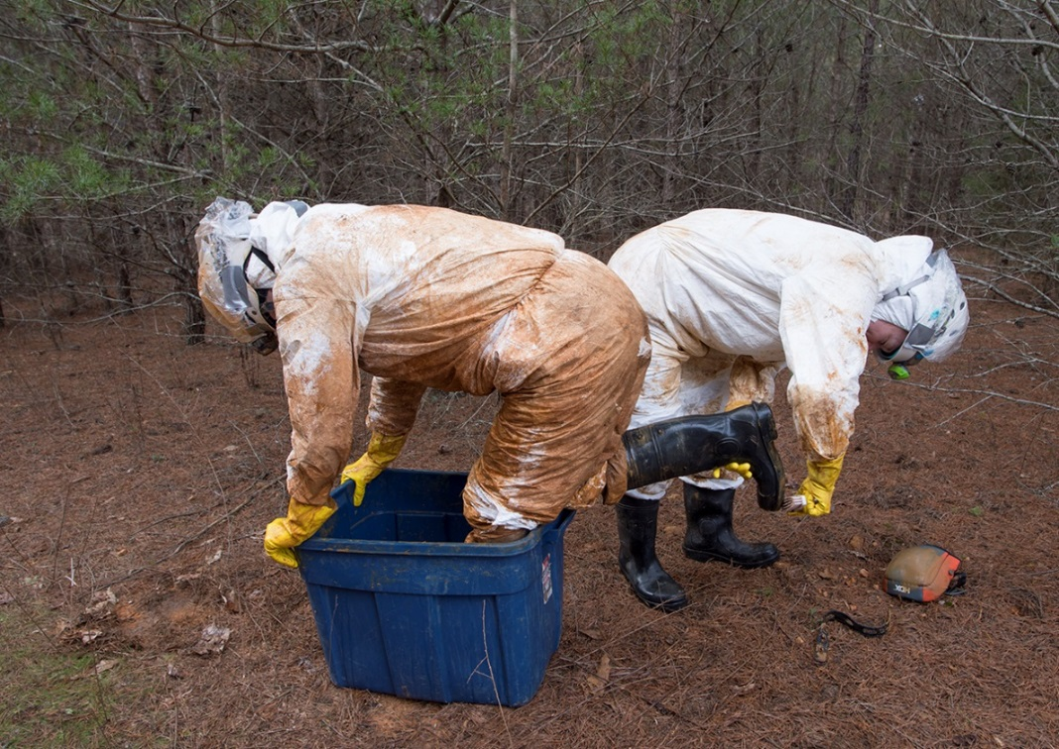
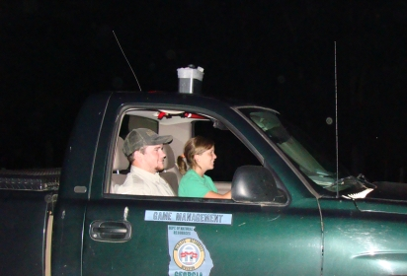
Volunteer with biologists and researchers in the cause
GADNR has an ongoing Acoustic volunteer survey program and can be found here:
http://www.georgiawildlife.com/anabatproject
Be mindful when caving and decontaminate any gear used
https://www.whitenosesyndrome.org/sites/default/files/resource/national_wns_decon_protocol_04.12.2016.pdf
Join the GA Bat Working Group or donate money to the group
Tom Whitehurst, SCCI caver
www.georgiawildlife.com

Slide 20
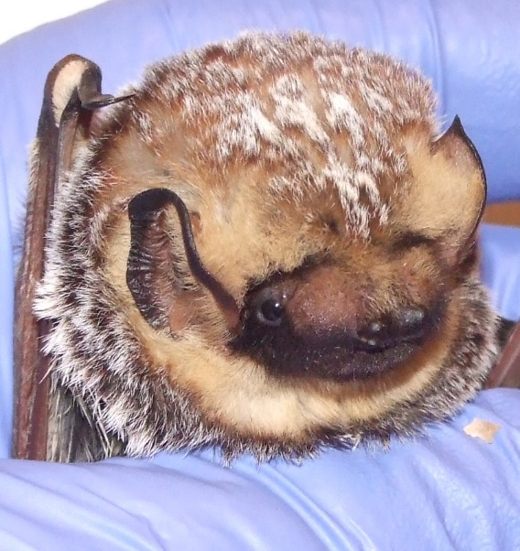
For more Information and For classroom activities about bats to engage students, go to: www.georgiawildlife.com www.gabats.org www.Pintrest.com www.batcon.org
Vicky Beckham Smith, A-Z Animals

