Slide 1
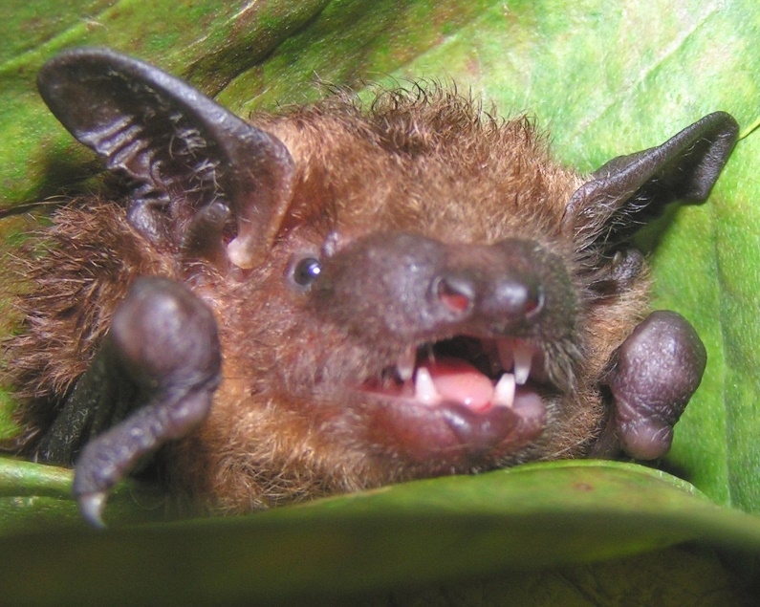
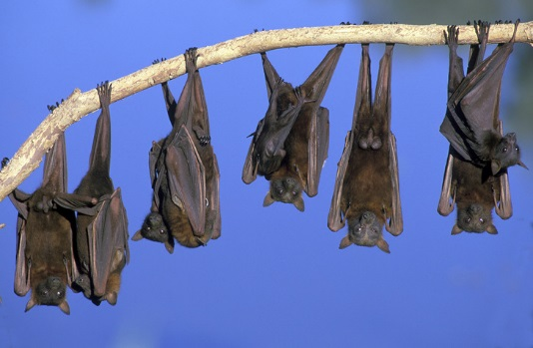
Bats of Georgia & Around the World
Vicky Beckham Smith
By: Georgia Bat
Working Group
crowarrowinc.wordpress.com

Slide 2
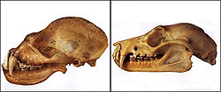
Species
Order Chiroptera (which is Greek for ‘hand wing’)
Second largest order of mammals (rodents are first) ~ 20% of all classified mammal species worldwide
Only mammal capable of flight
1,240 different species worldwide
Two suborders: Megabats and Microbats
skywalker.cochise.edu

Slide 3
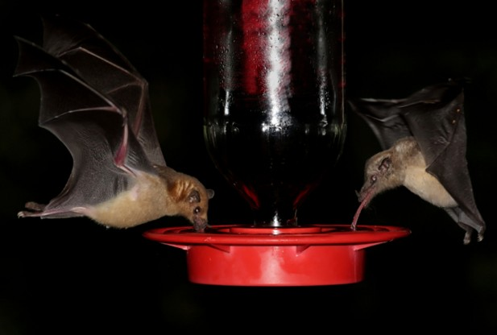
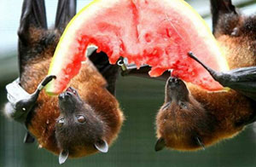
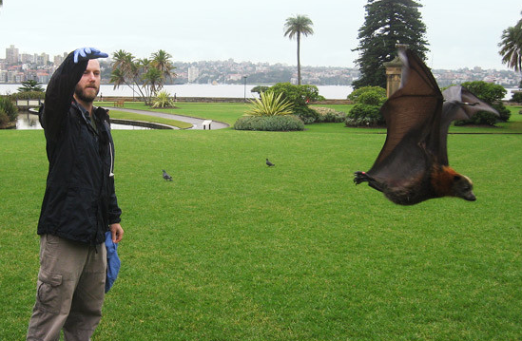
Megabats
Feed on fruits and nectar from flowers
Smallest species is 2.4 inches long and 25 grams
Largest is 5.6 feet in wingspan and weighs 3.5 pounds
They use their ears, nose, and eyes for getting around and finding their food
Most roost in trees and shrubs though some roost in caves
www.redorbit.com
www.essexonlakechamplain.com
www.batsrule.info

Slide 4
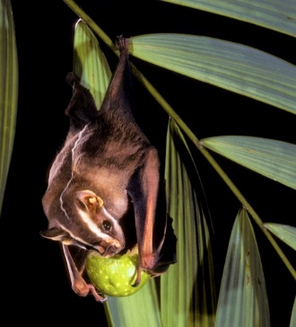
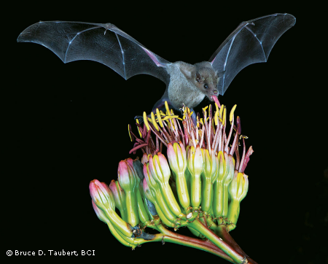
Benefits of Megabats
Pollinators
Nectar-eating bat species pollinate much of the produce you see at your local supermarket. Such as: bananas, peaches, mango, durian, guava, and agave (tequila), among others
Seed Distributors
Fruit-eating bats disperse seeds critical to restoring cleared or damaged rainforests
Sometimes called “Farmers of the tropics”
Avocados, dates, figs and cashews, among others are plants that benefit from bats seed dispersal
www.bci.org

Slide 5
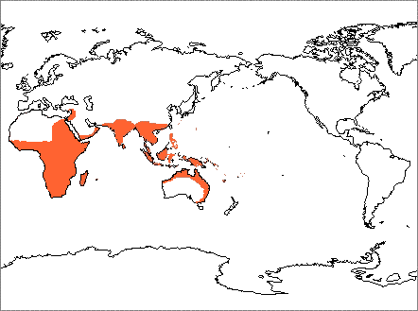
Megabat Distribution
www.nhc.ed.ac.uk

Slide 6
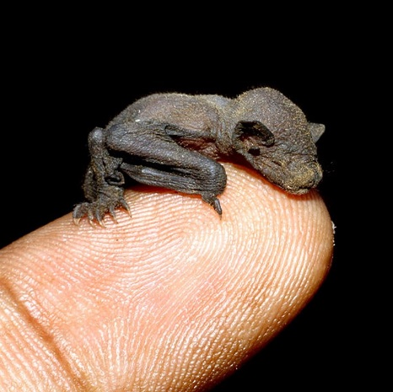
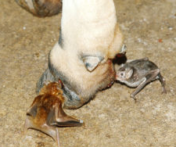
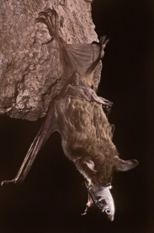
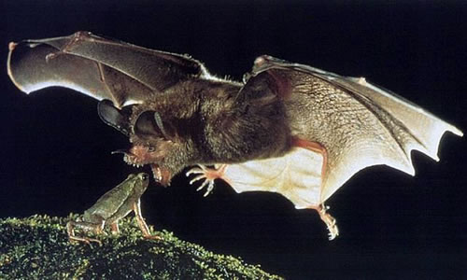
Microbats
Feed on insects, other small invertebrates, fish, frogs, lizards, birds, other bats and some feed on blood from mammals and birds
Smallest species is 1.14 inches long and weighs 2 grams
Largest is 39 inches in wingspan and weighs 190 grams
Use Echolocation to find food
Most have good sight– helps in
flight at night
Most roost in caves as well as and some trees but some will roost in man-made structures
www.anoleannals.org
www.capefearwildlife.com
www.thebatcave.ca
stjohnsabbatical.com
bajubekasbranded.com

Slide 7
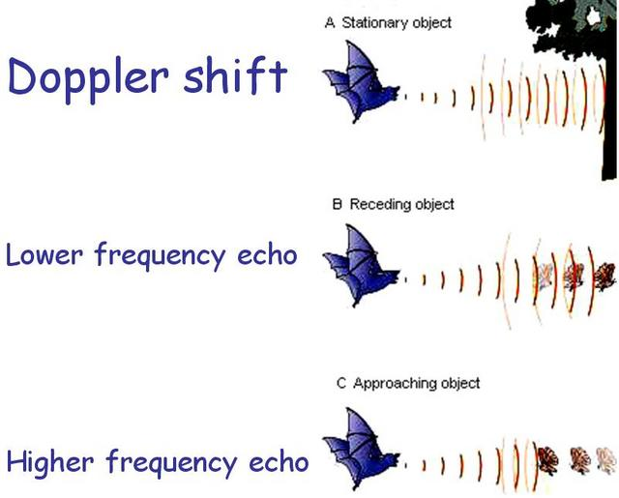
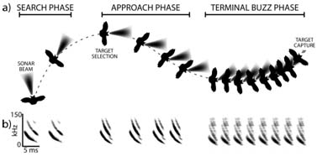
Microbats and Echolocation
bbs.stardestroyer.net
Microbats generate ultrasound via the larynx and emit the sound through the nose or the open mouth. Microbat calls range in frequency from 14,000 to over 100,000 kilohertz, kHz (typical human hearing range is considered to be from 20 to 20,000 kHz).
www.batlab.umd.edu
incolors.club

Slide 8
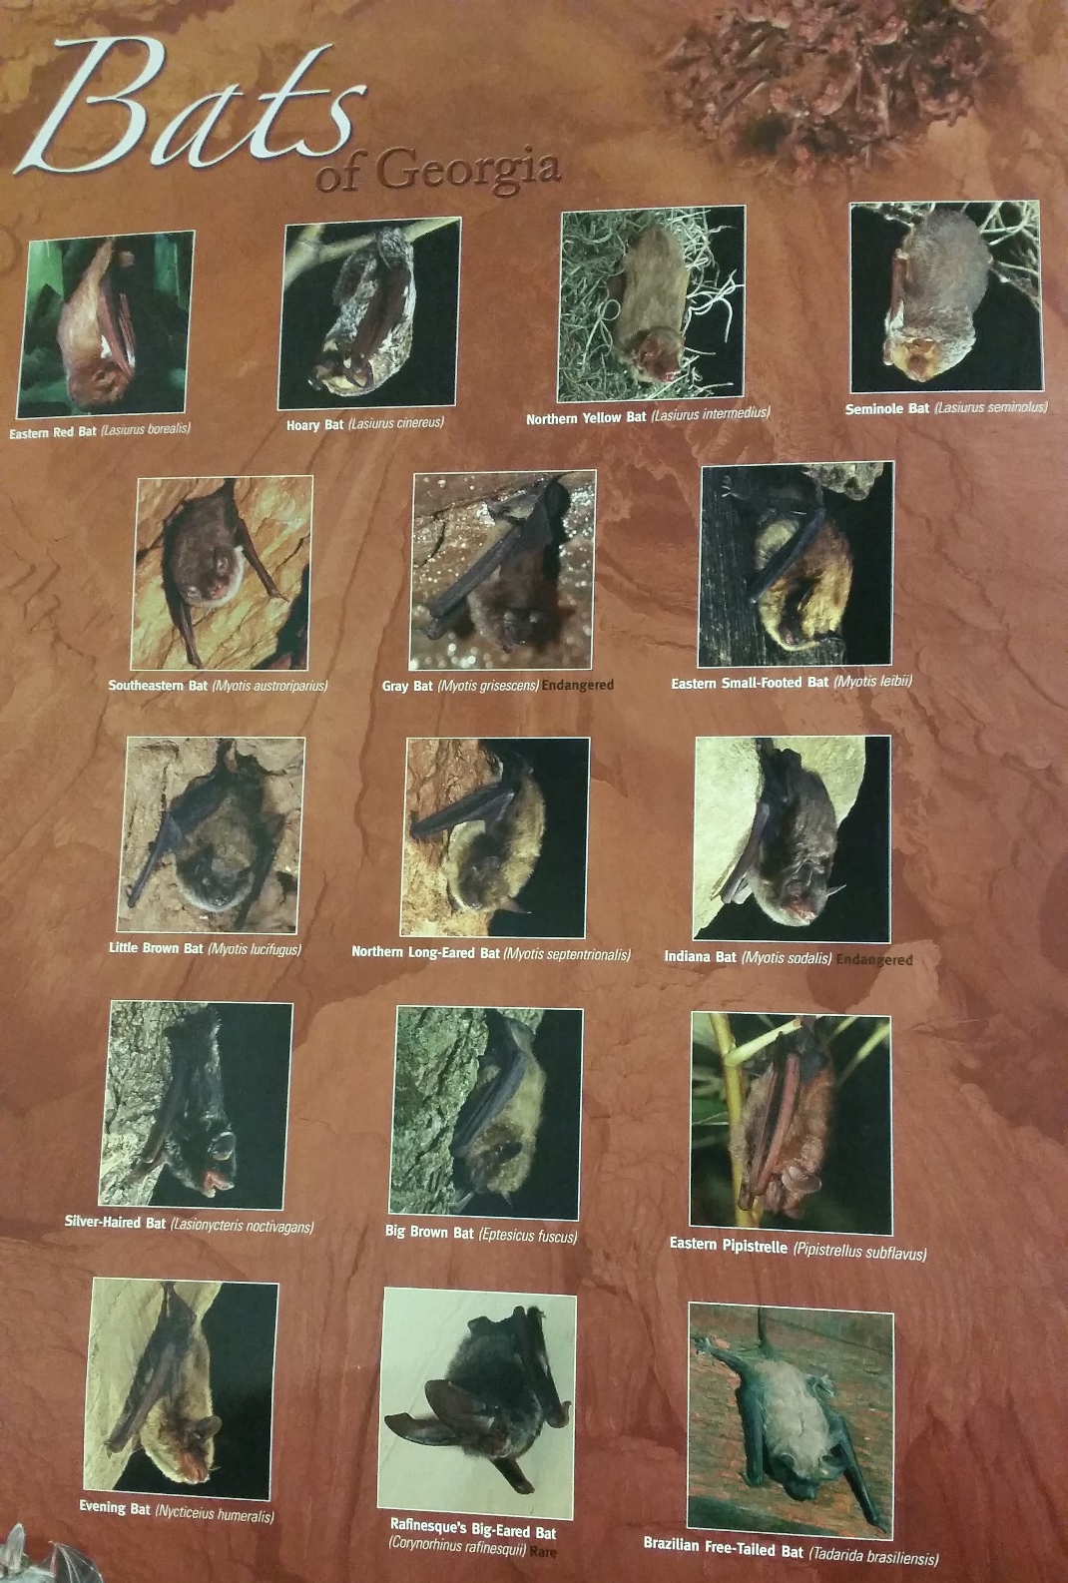
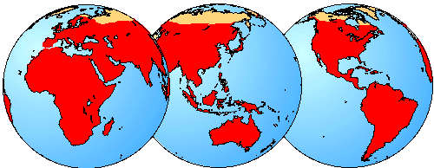
Microbat Distribution
16 species located in Georgia
Located all over the world except in the Arctic and Antarctic
www.nhc.ed.ac.uk
Taken by: Kim Romano
Poster made by: BCI, T.E.R.N., and GA Power

Slide 9
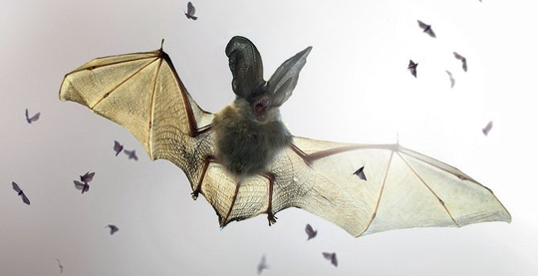
Why are Microbats Important in GA?
They can consume 300-500 mosquitoes and mosquito sized insects in one hour!
Help maintain a fragile insect predator-prey balance for our ecosystem
Save farmers billions of dollars in pesticide use and crop protection
Help maintain healthy crops for farmers and foresters.
The alternative to bats is greater pesticide use, which brings another set of ecological concerns
www.greenstrides.com

Slide 10
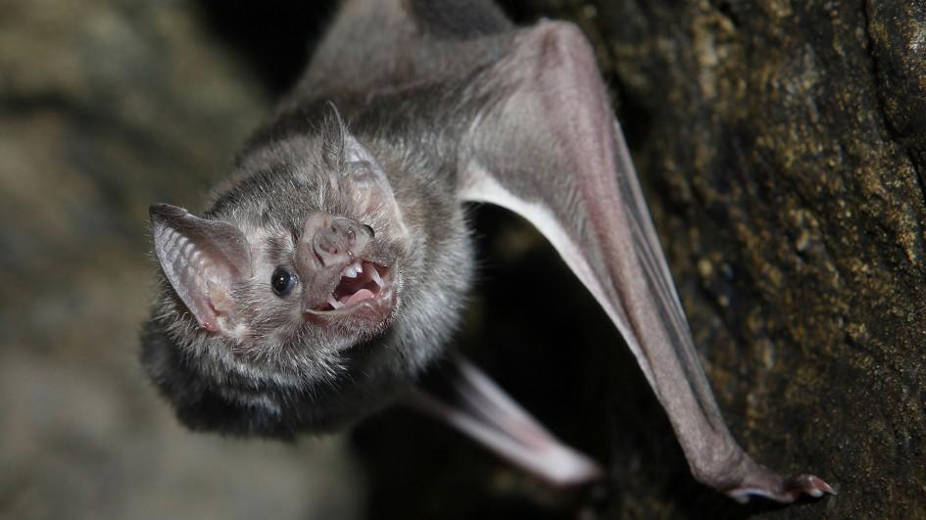
Other Benefits of Microbats
Medicine
There are only 3 species of sangivorous bats-- all found in Central and South America
The anticoagulant in a vampire bat saliva is used in medicine to increase blood flow in stroke patients
Nationalgeographic.com

Slide 11
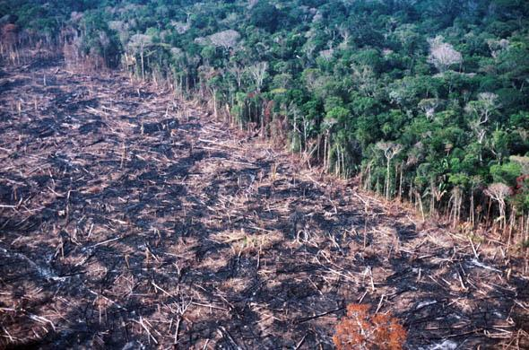
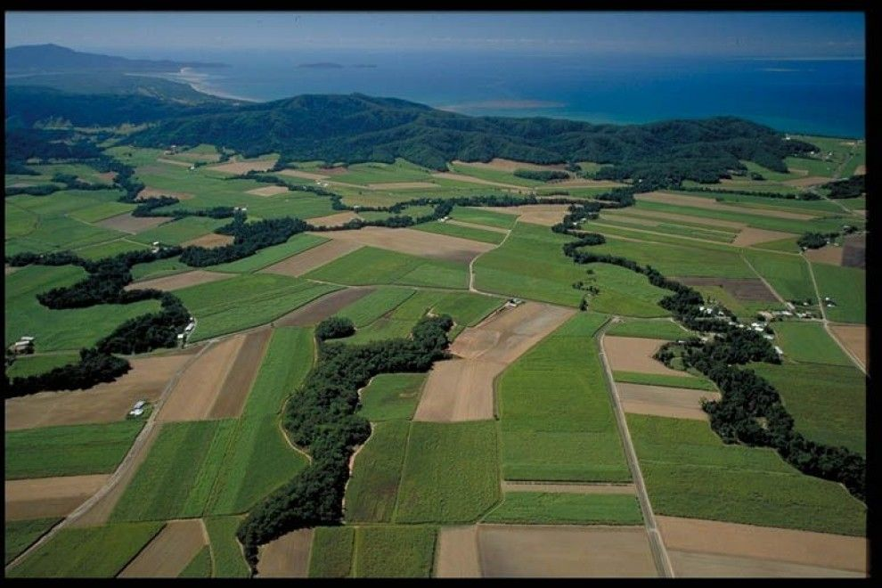
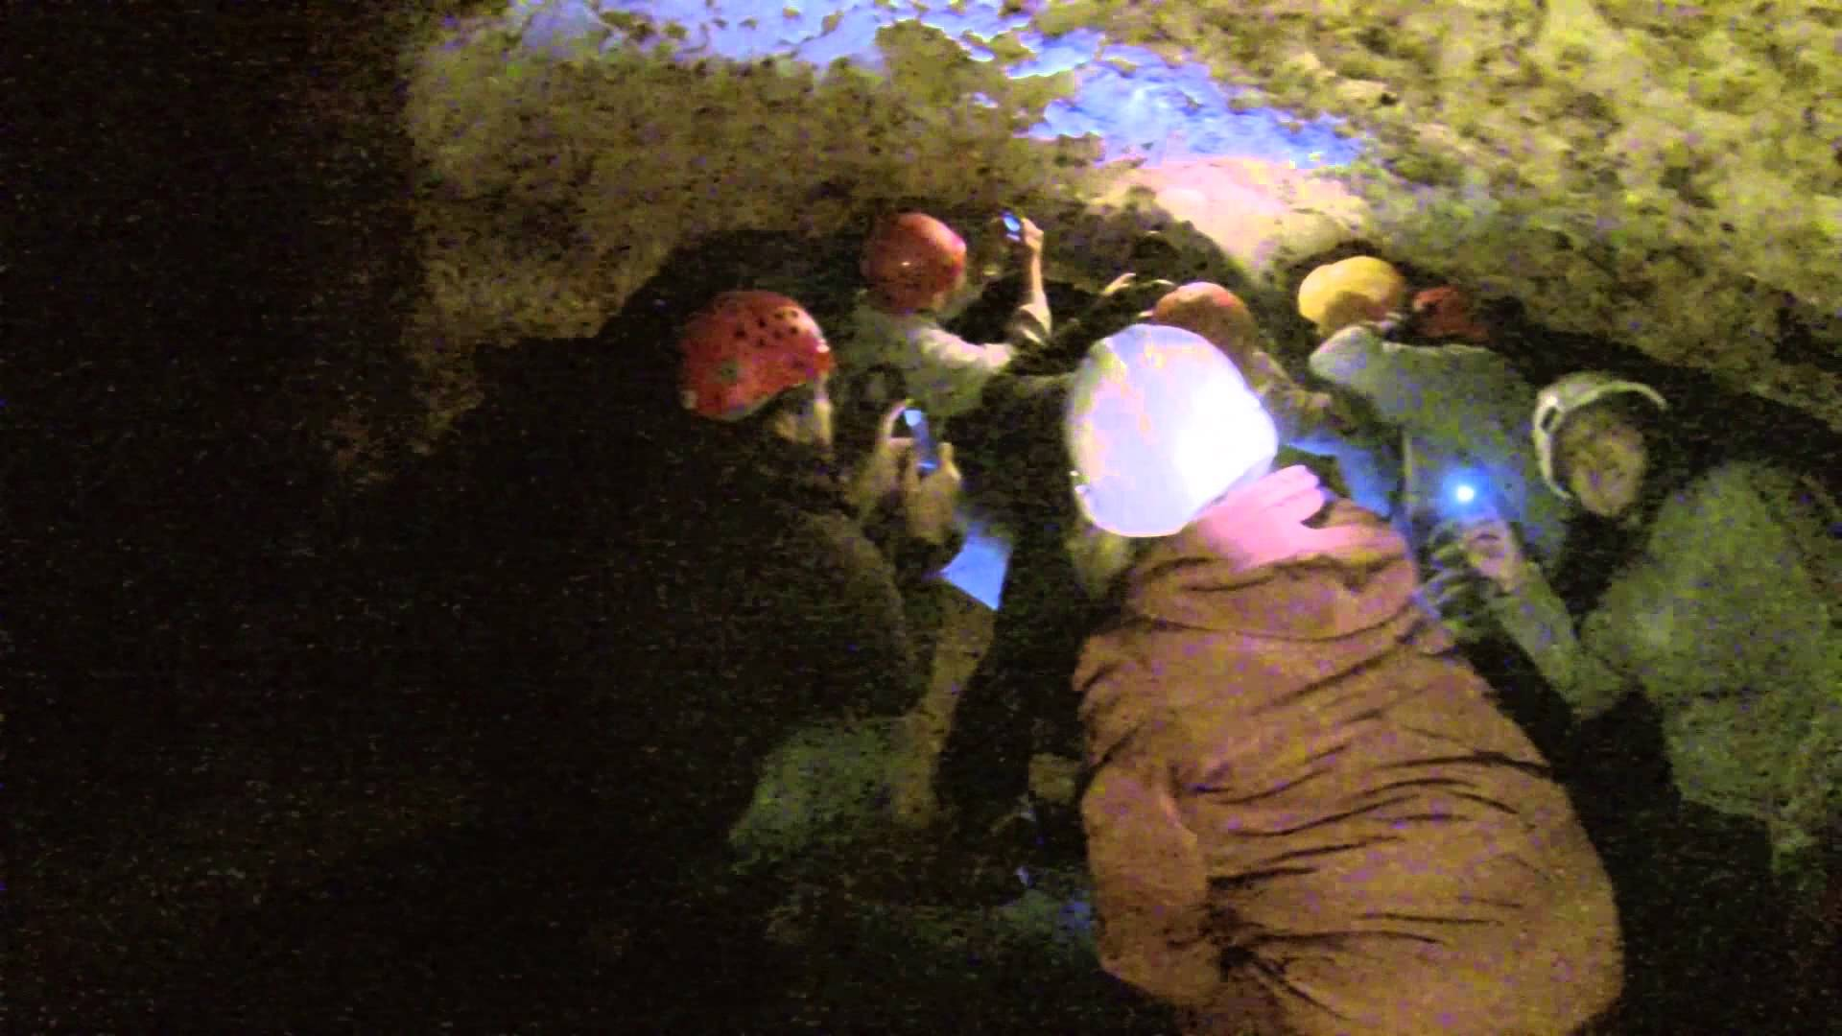
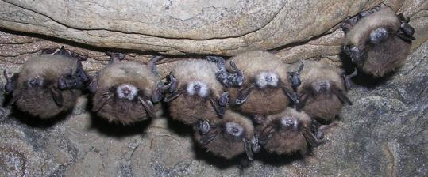
Losing Our Bats
Deforestation
Disturbance in caves
Habitat fragmentation
White-nose syndrome
www.ibtimes.com
www.gardenerscoach.com
www.youtube.com
www.fws.gov

Slide 12
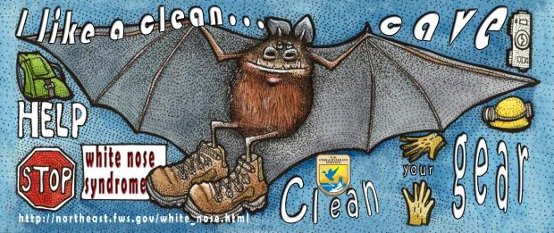
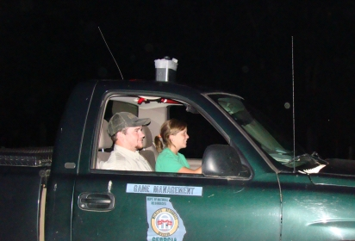
What Can You Do to Help?
EDUCATE friends, family, and kids.
Volunteer your time to help a biologist or researcher in the cause
GADNR has an ongoing Acoustic volunteer survey program and can be found here:
http://www.georgiawildlife.com/anabatproject
Build bat houses in your backyard
If you are an avid caver, properly clean your gear when leaving the cave and before going into the next cave to help prevent the spread of white-nose syndrome. Website found below:
https://www.whitenosesyndrome.org/sites/default/files/resource/national_wns_revise_final_6.25.12.pdf
Join the GA Bat Networking Group or donate money to the group
www.georgiawildlife.com
www.georgiawildlife.com

Slide 13
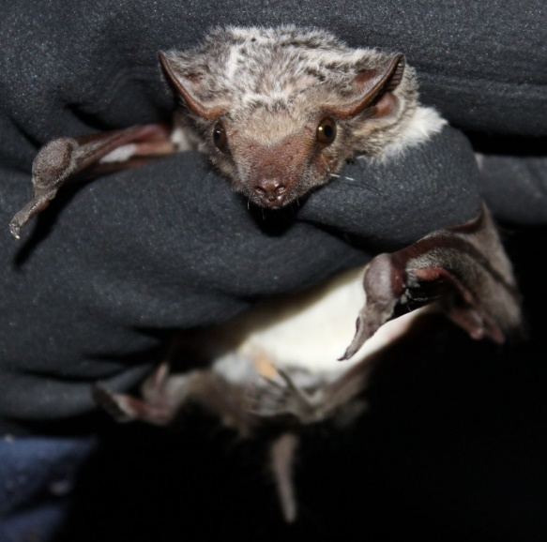
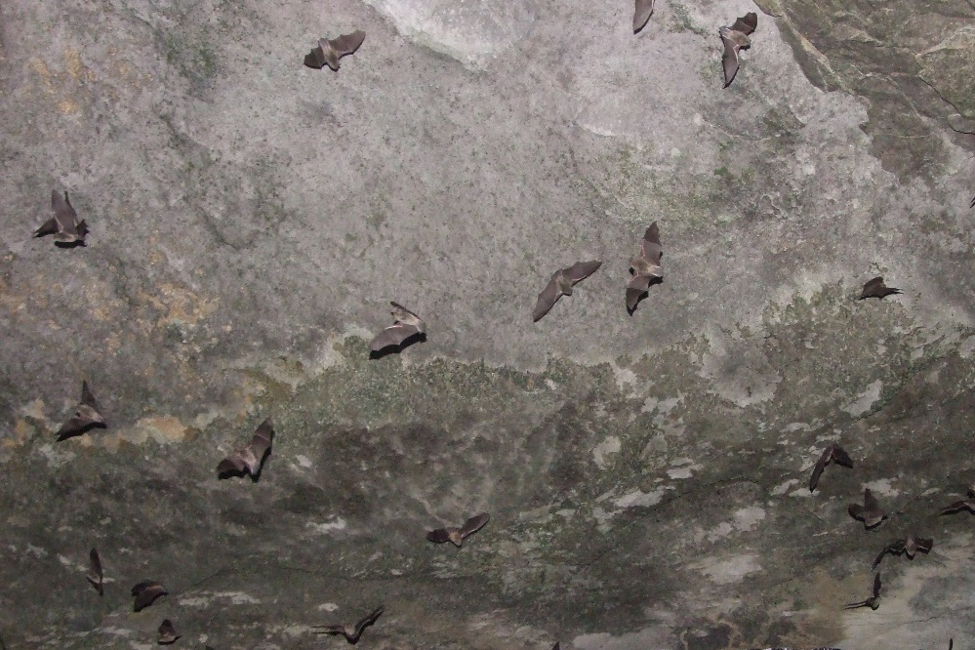
For more information, go to: www.georgiawildlife.com www.gabats.org www.batcon.org
www.thabaphaswa.co.za
Vicky Beckham Smith

